Slide 1
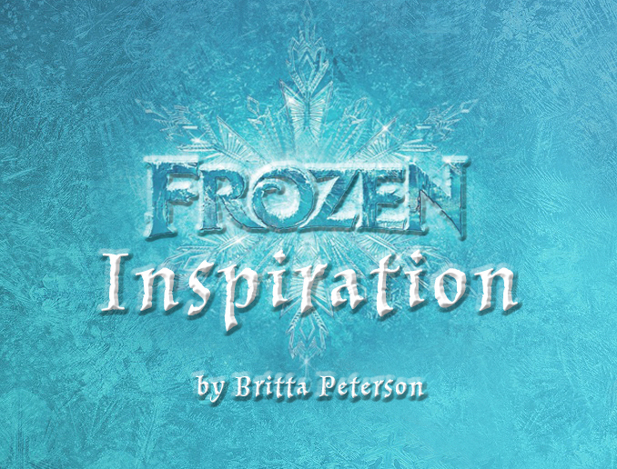

Slide 3
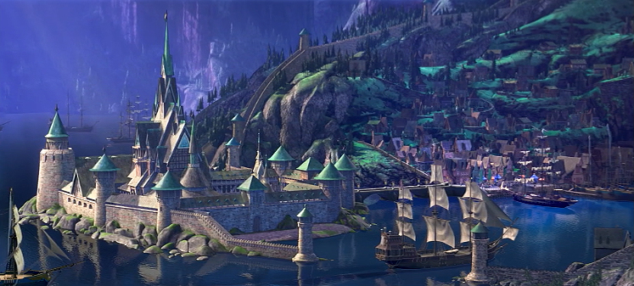
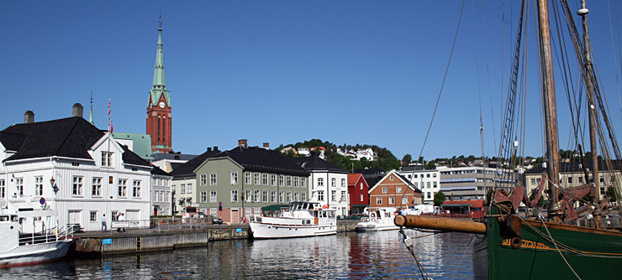
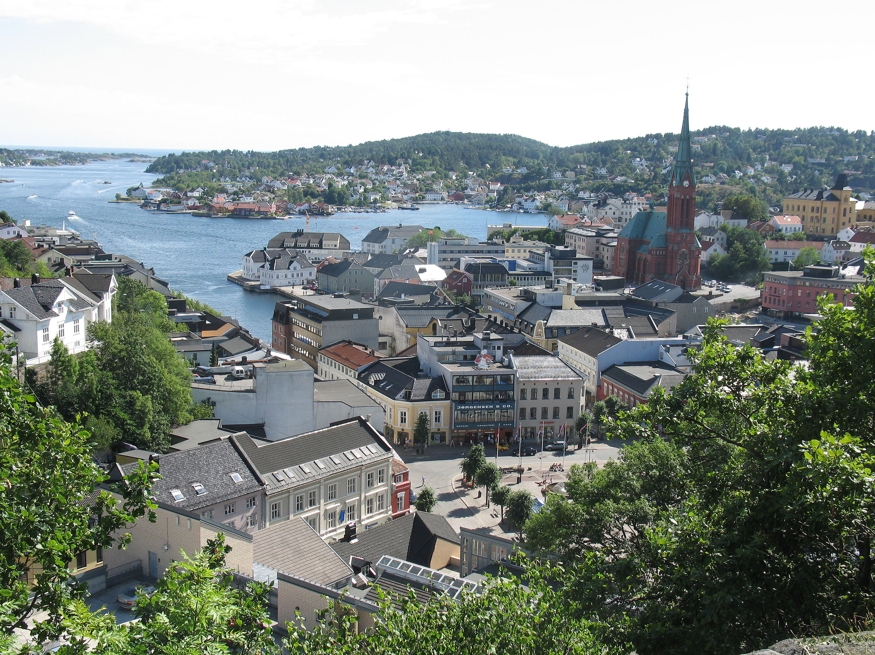
In the movie Frozen, Queen Elsa rules Arendelle.
Arendal is a real town on the south coast of Norway, originally called Arendall when it was established in the 16th century.

Slide 4
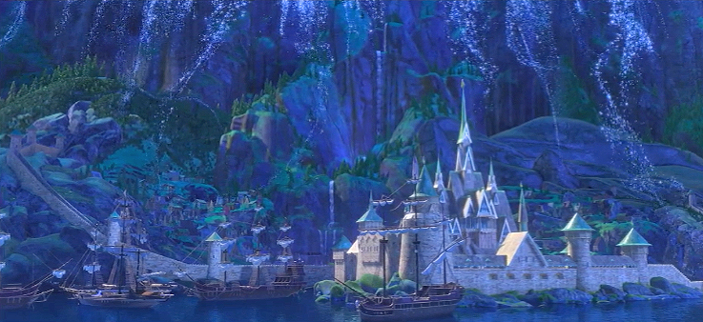
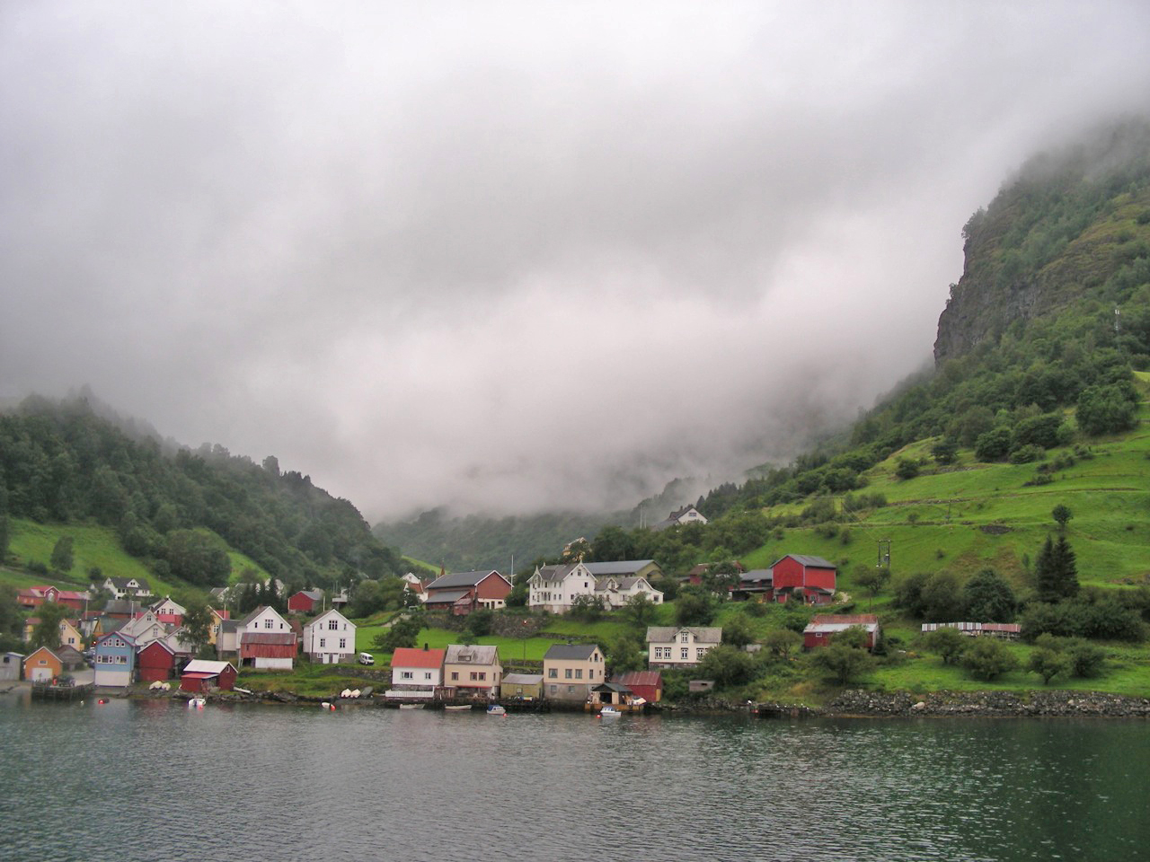
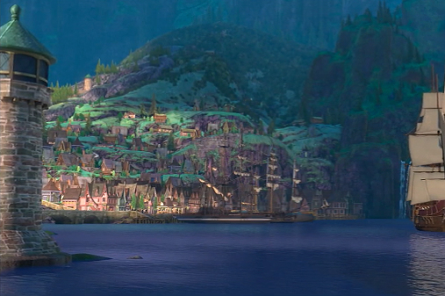
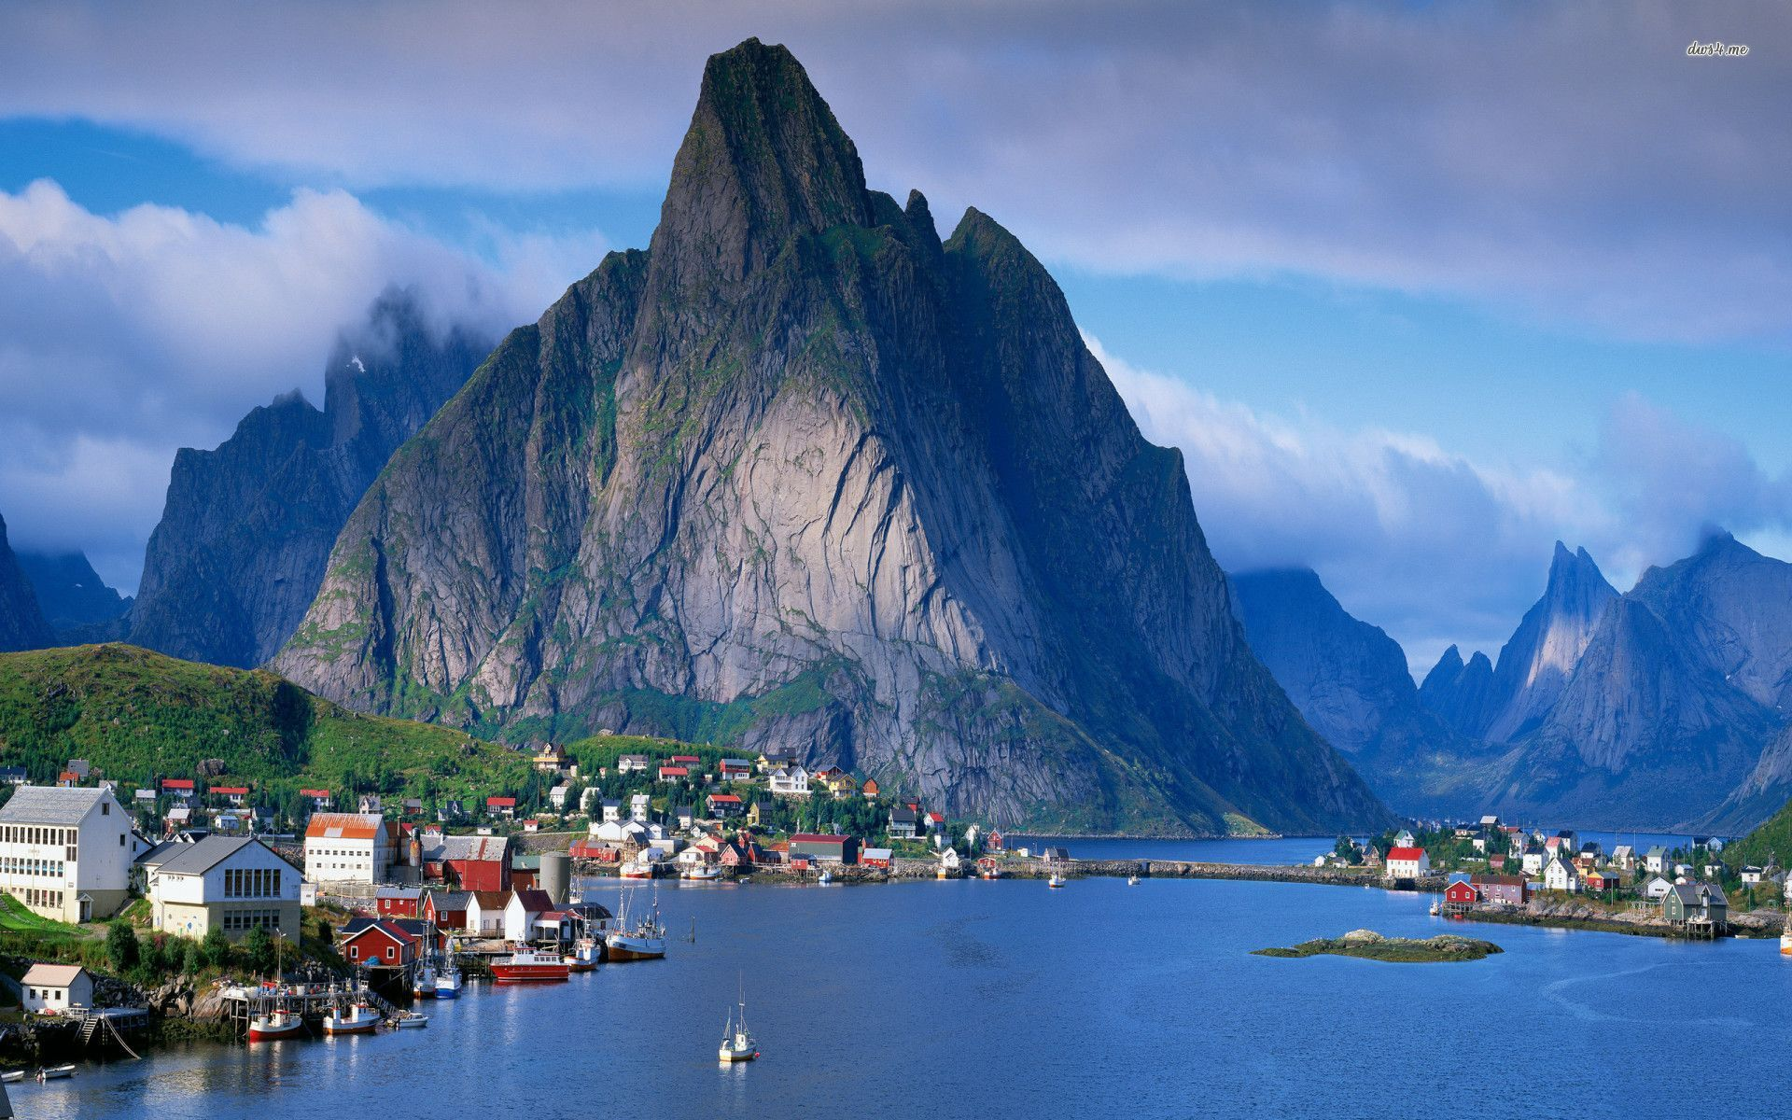
However, the landscape around Frozen's Arendelle is definitely inspired by the western fjords of Norway, not the southern coast.

Slide 5
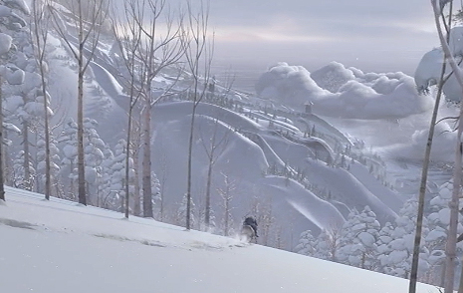
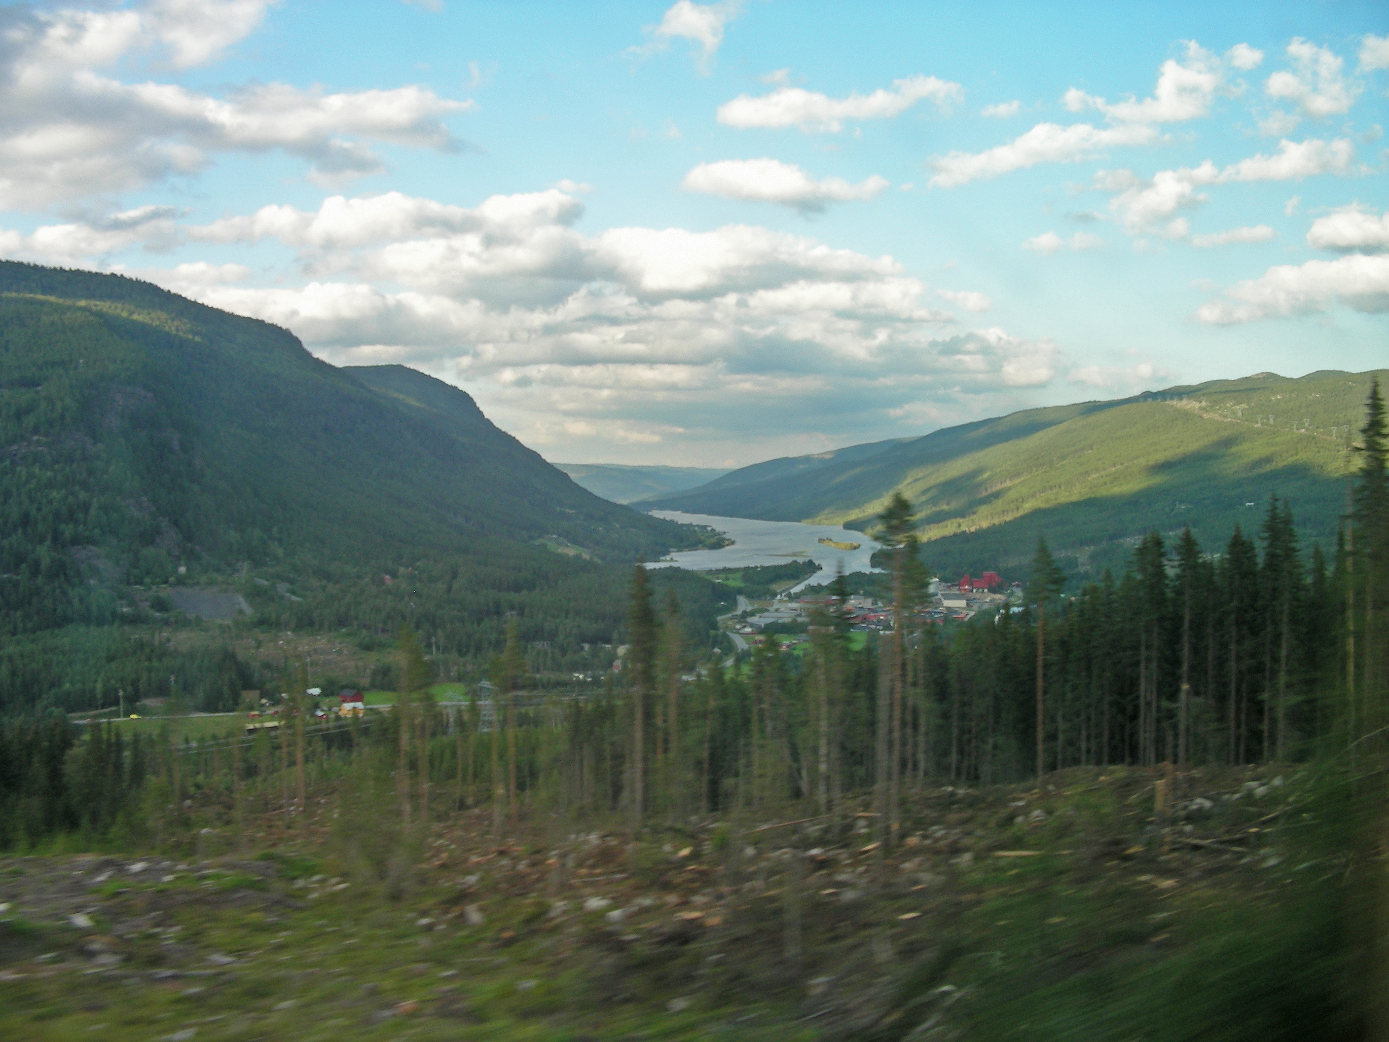
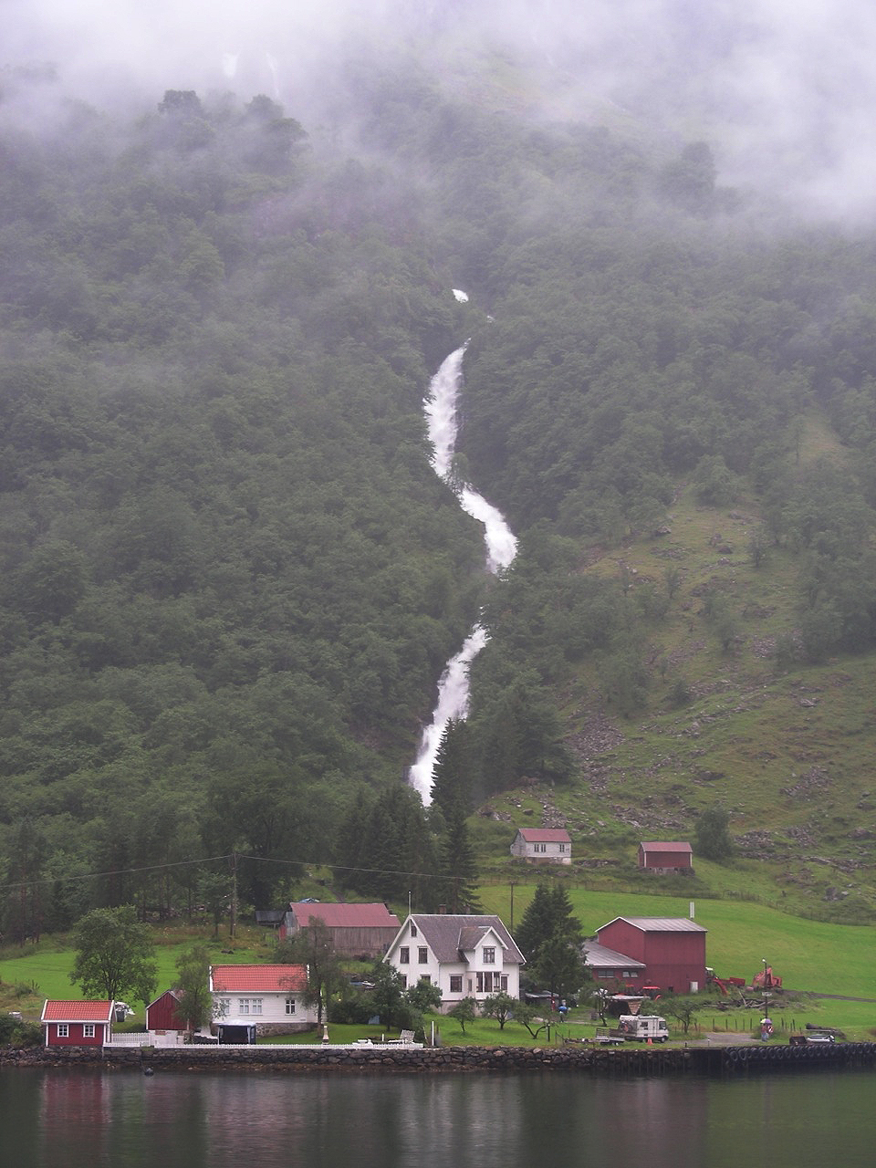
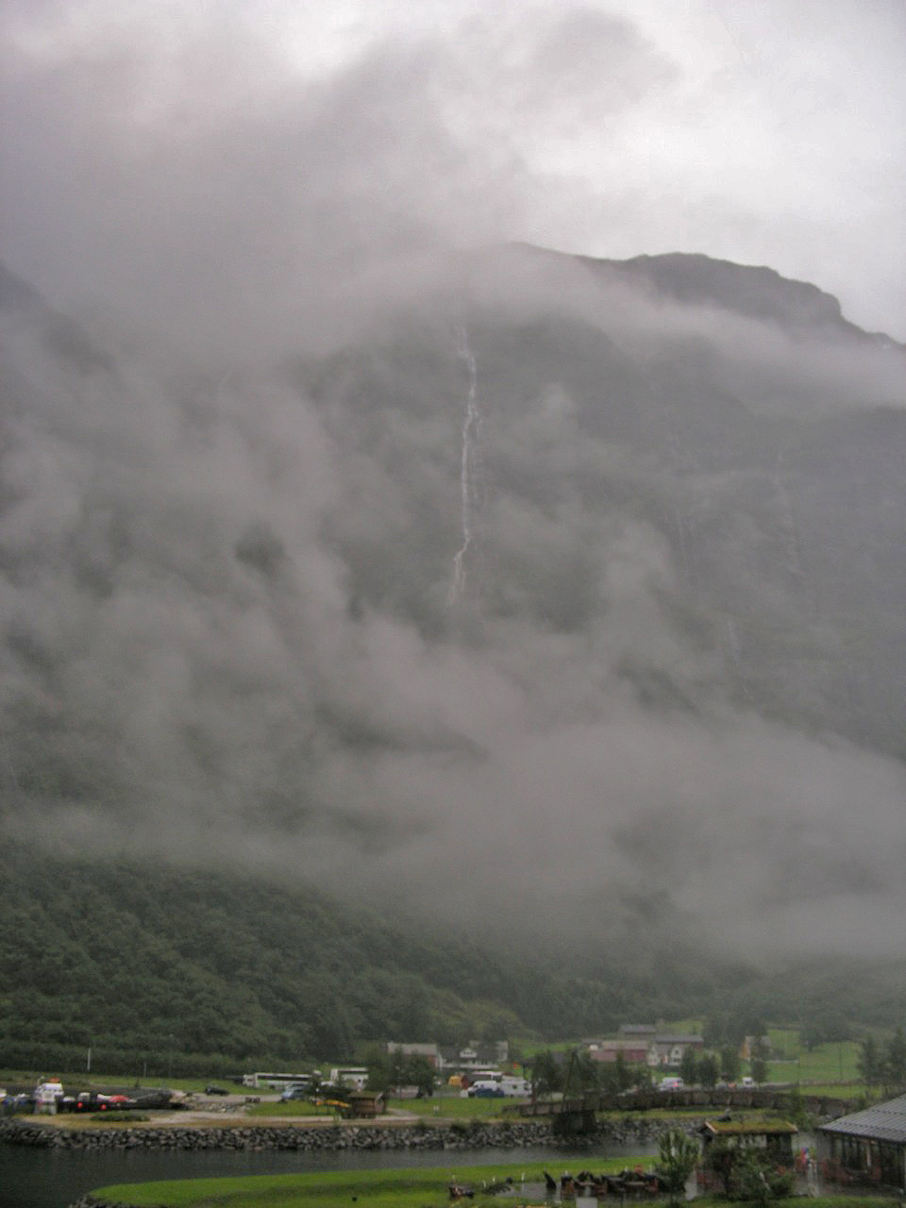
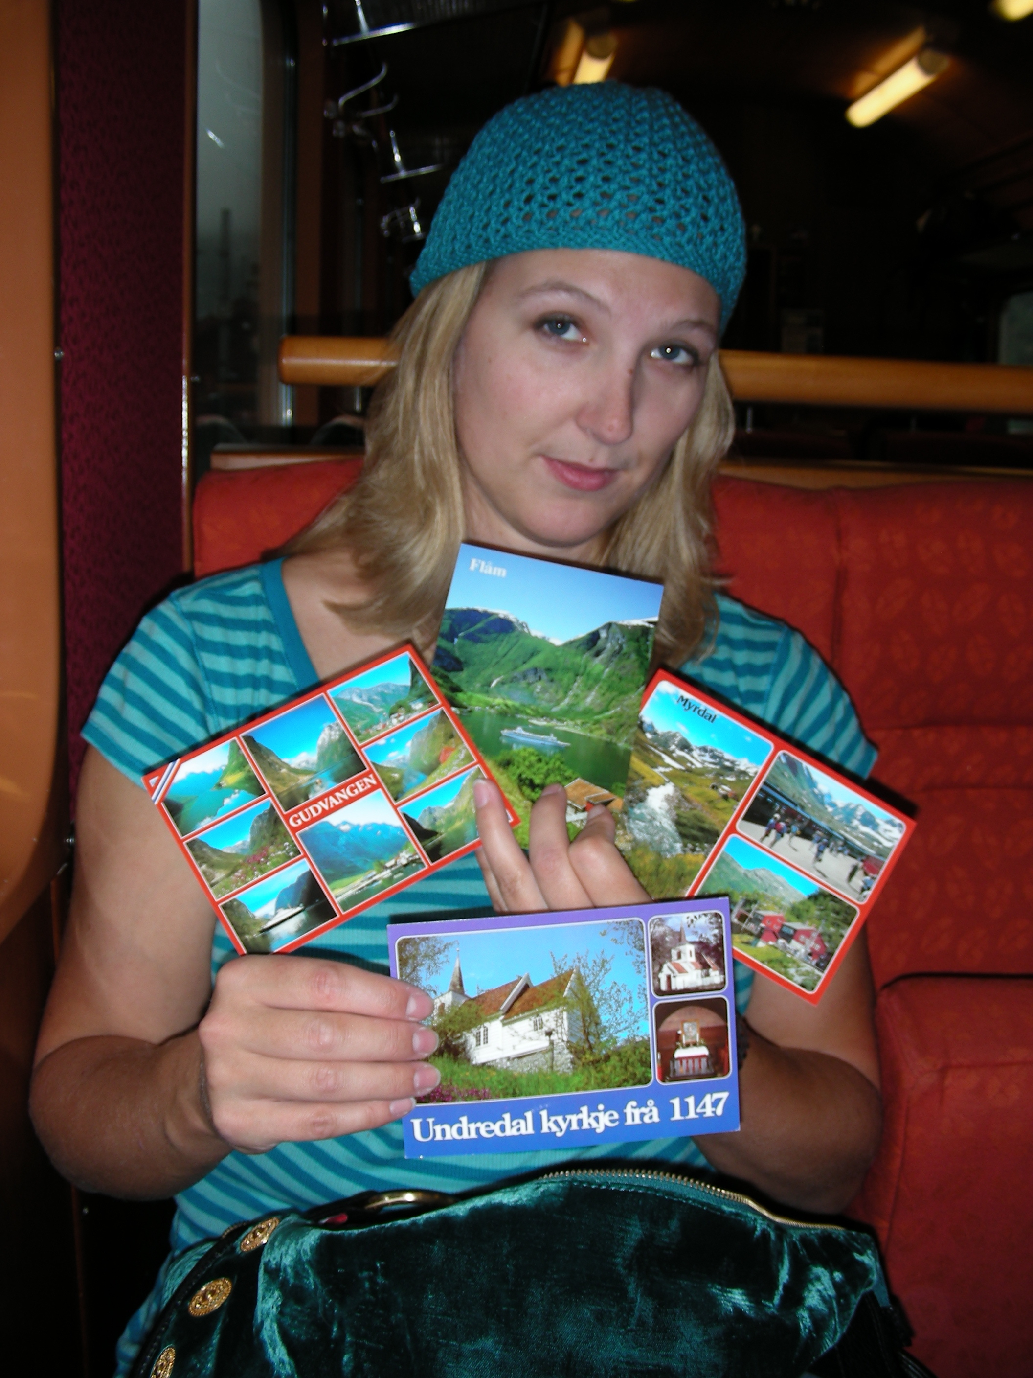
The Sognefjord area in Western Norway is included on the Norway in a Nutshell tour. I had bad weather luck on my tour and couldn’t even see across Naerofjord, so I had to buy postcards instead!

Slide 6
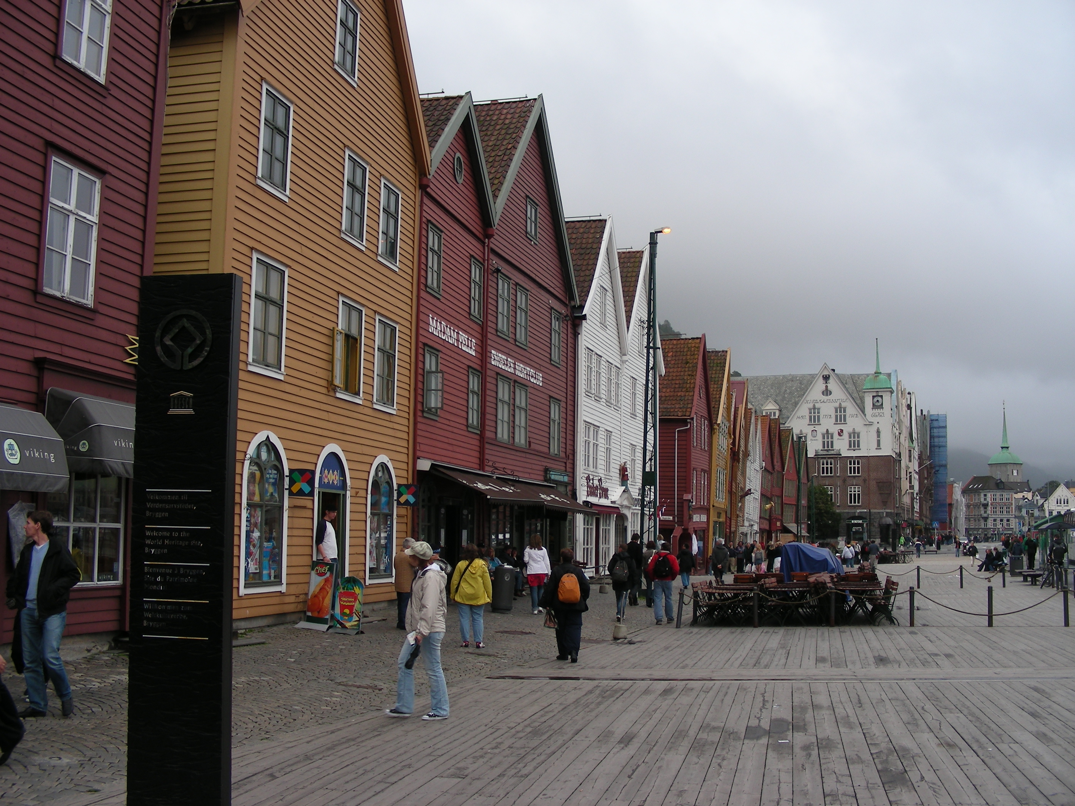
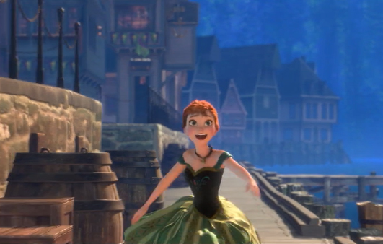
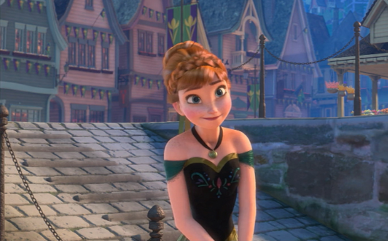
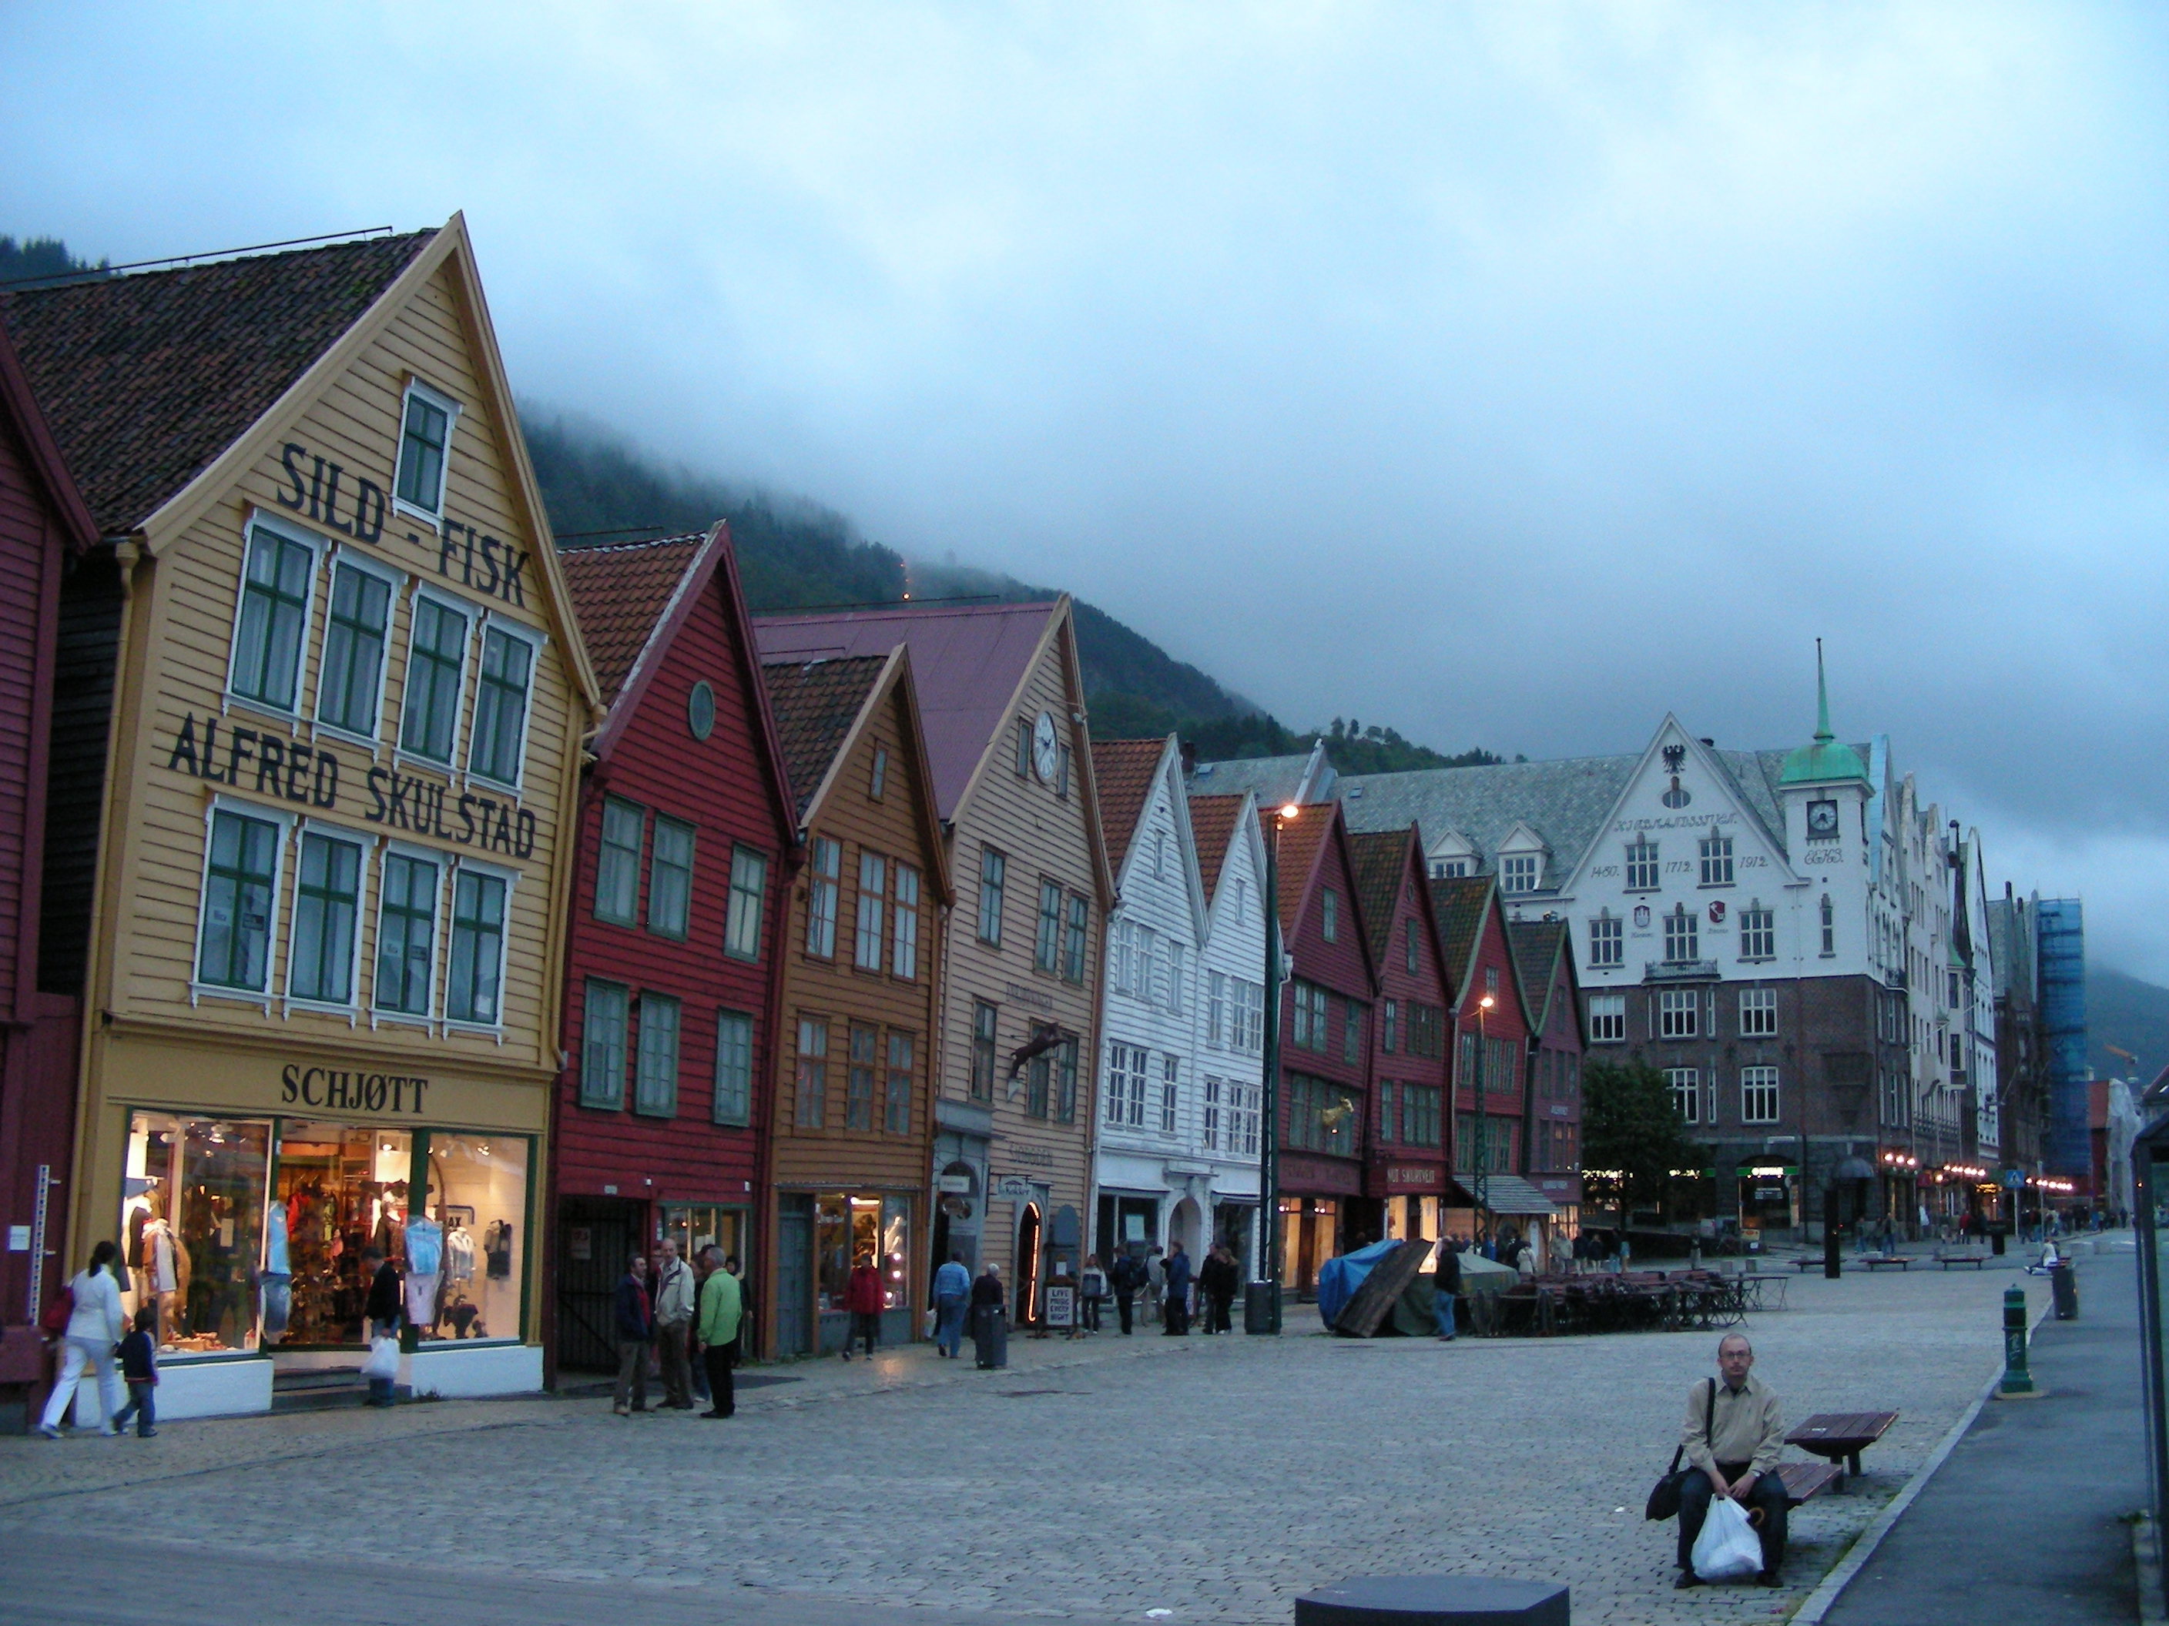
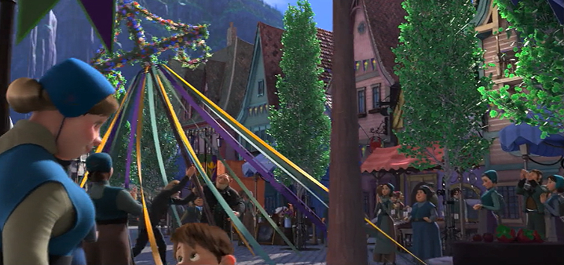
The Disney animation team toured Norway for inspiration, including the Bryggen wharf in Bergen. You can see similar houses along Arendelle harbor.

Slide 7
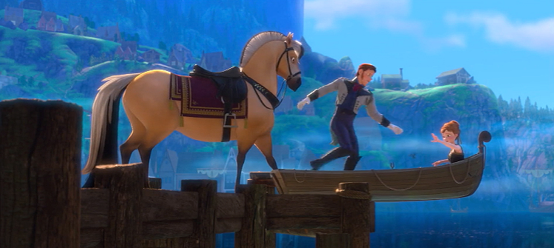
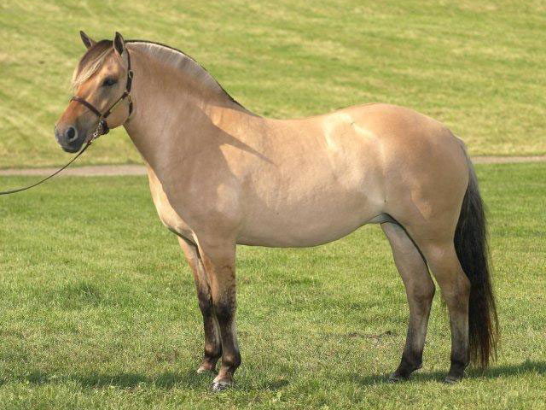
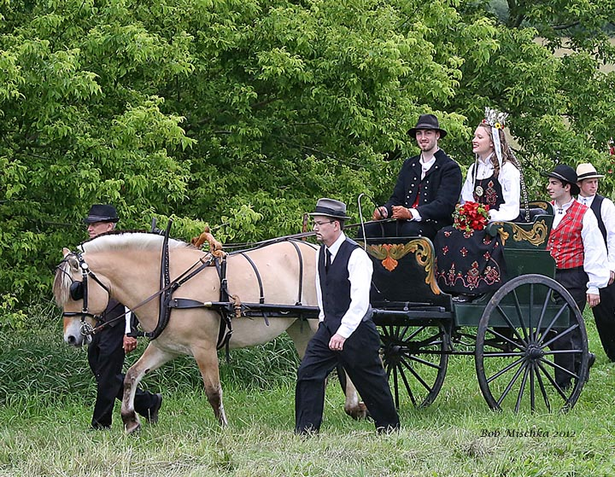
Even the uniquely Norwegian Fjord Horse makes an appearance!

Slide 8
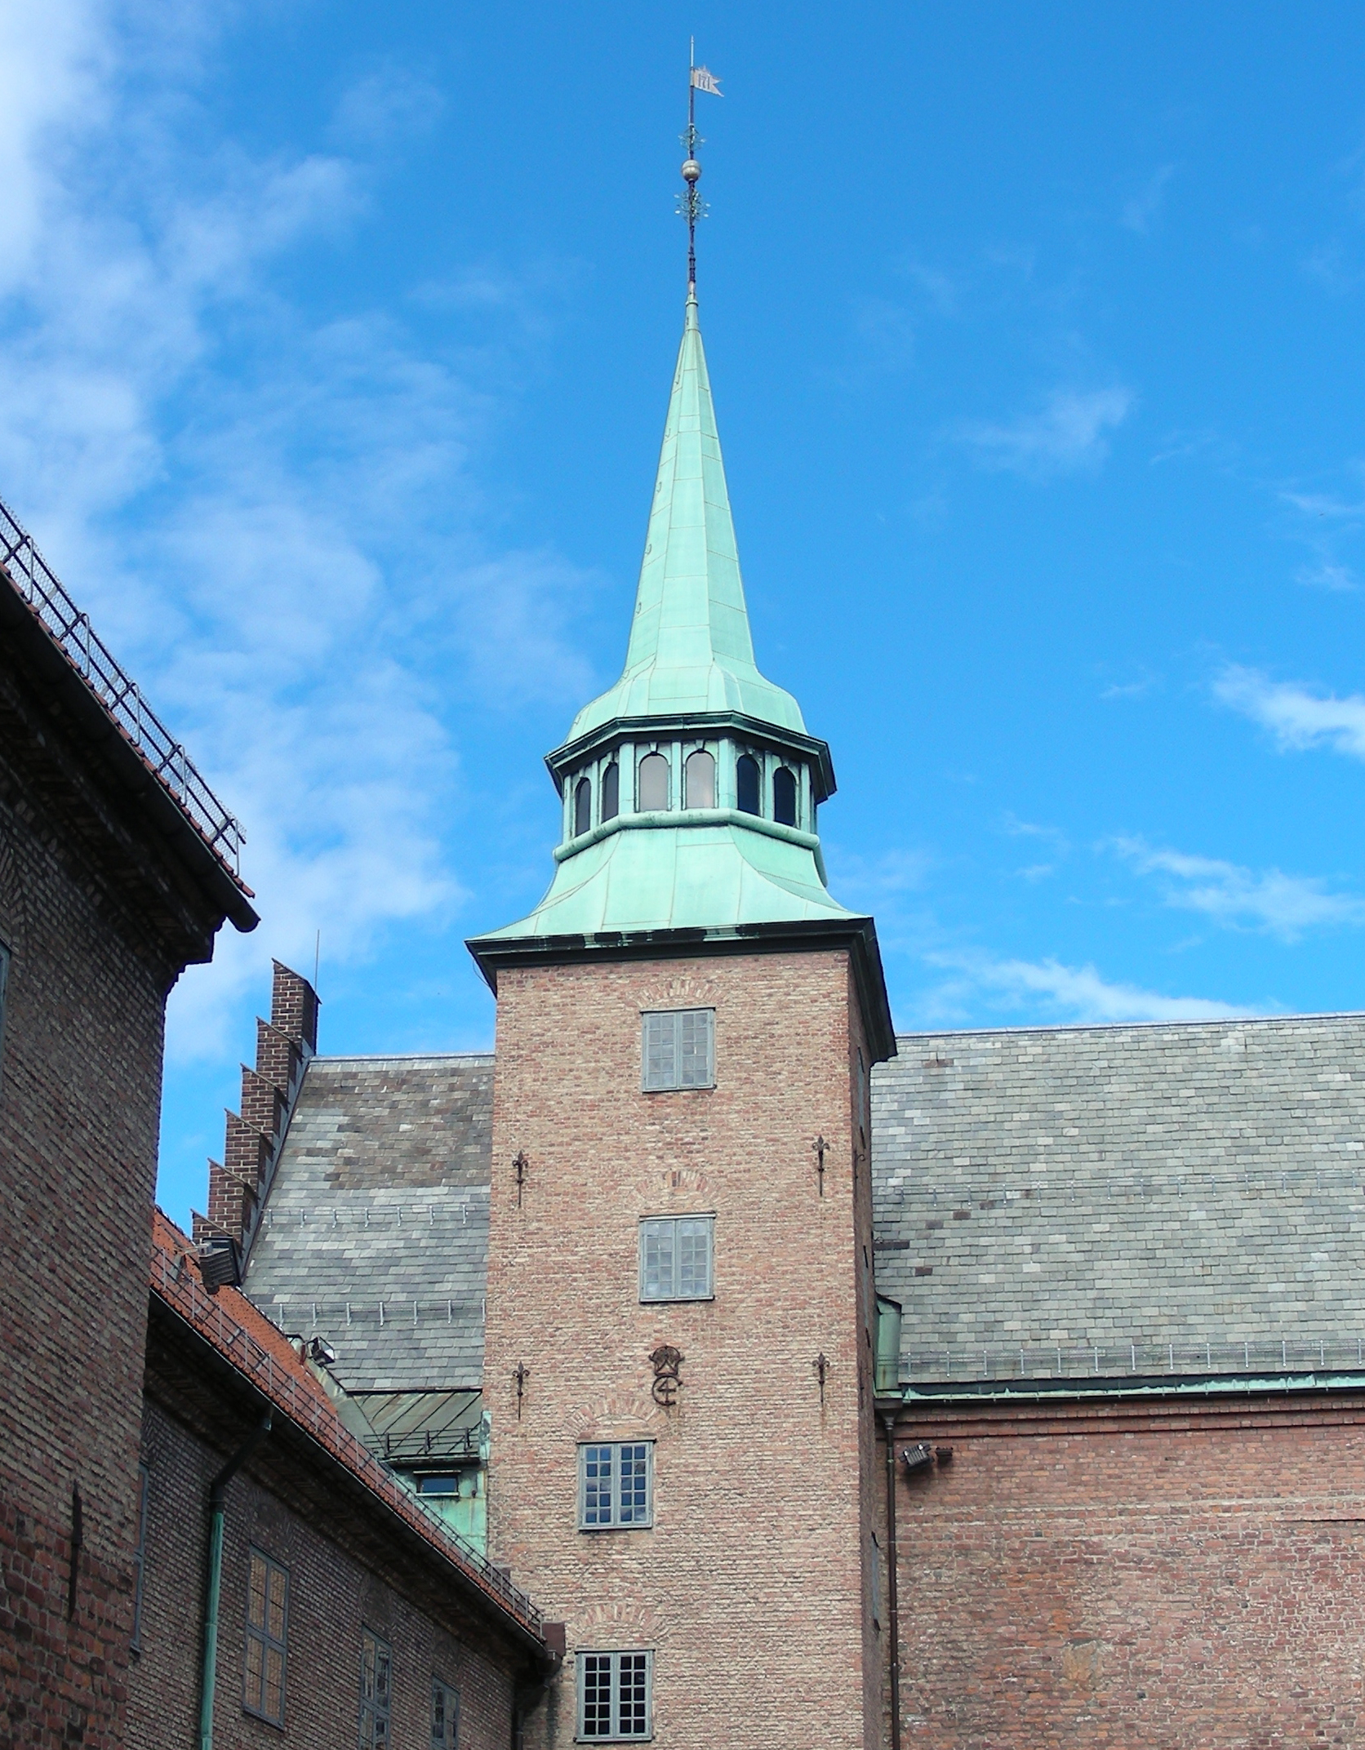
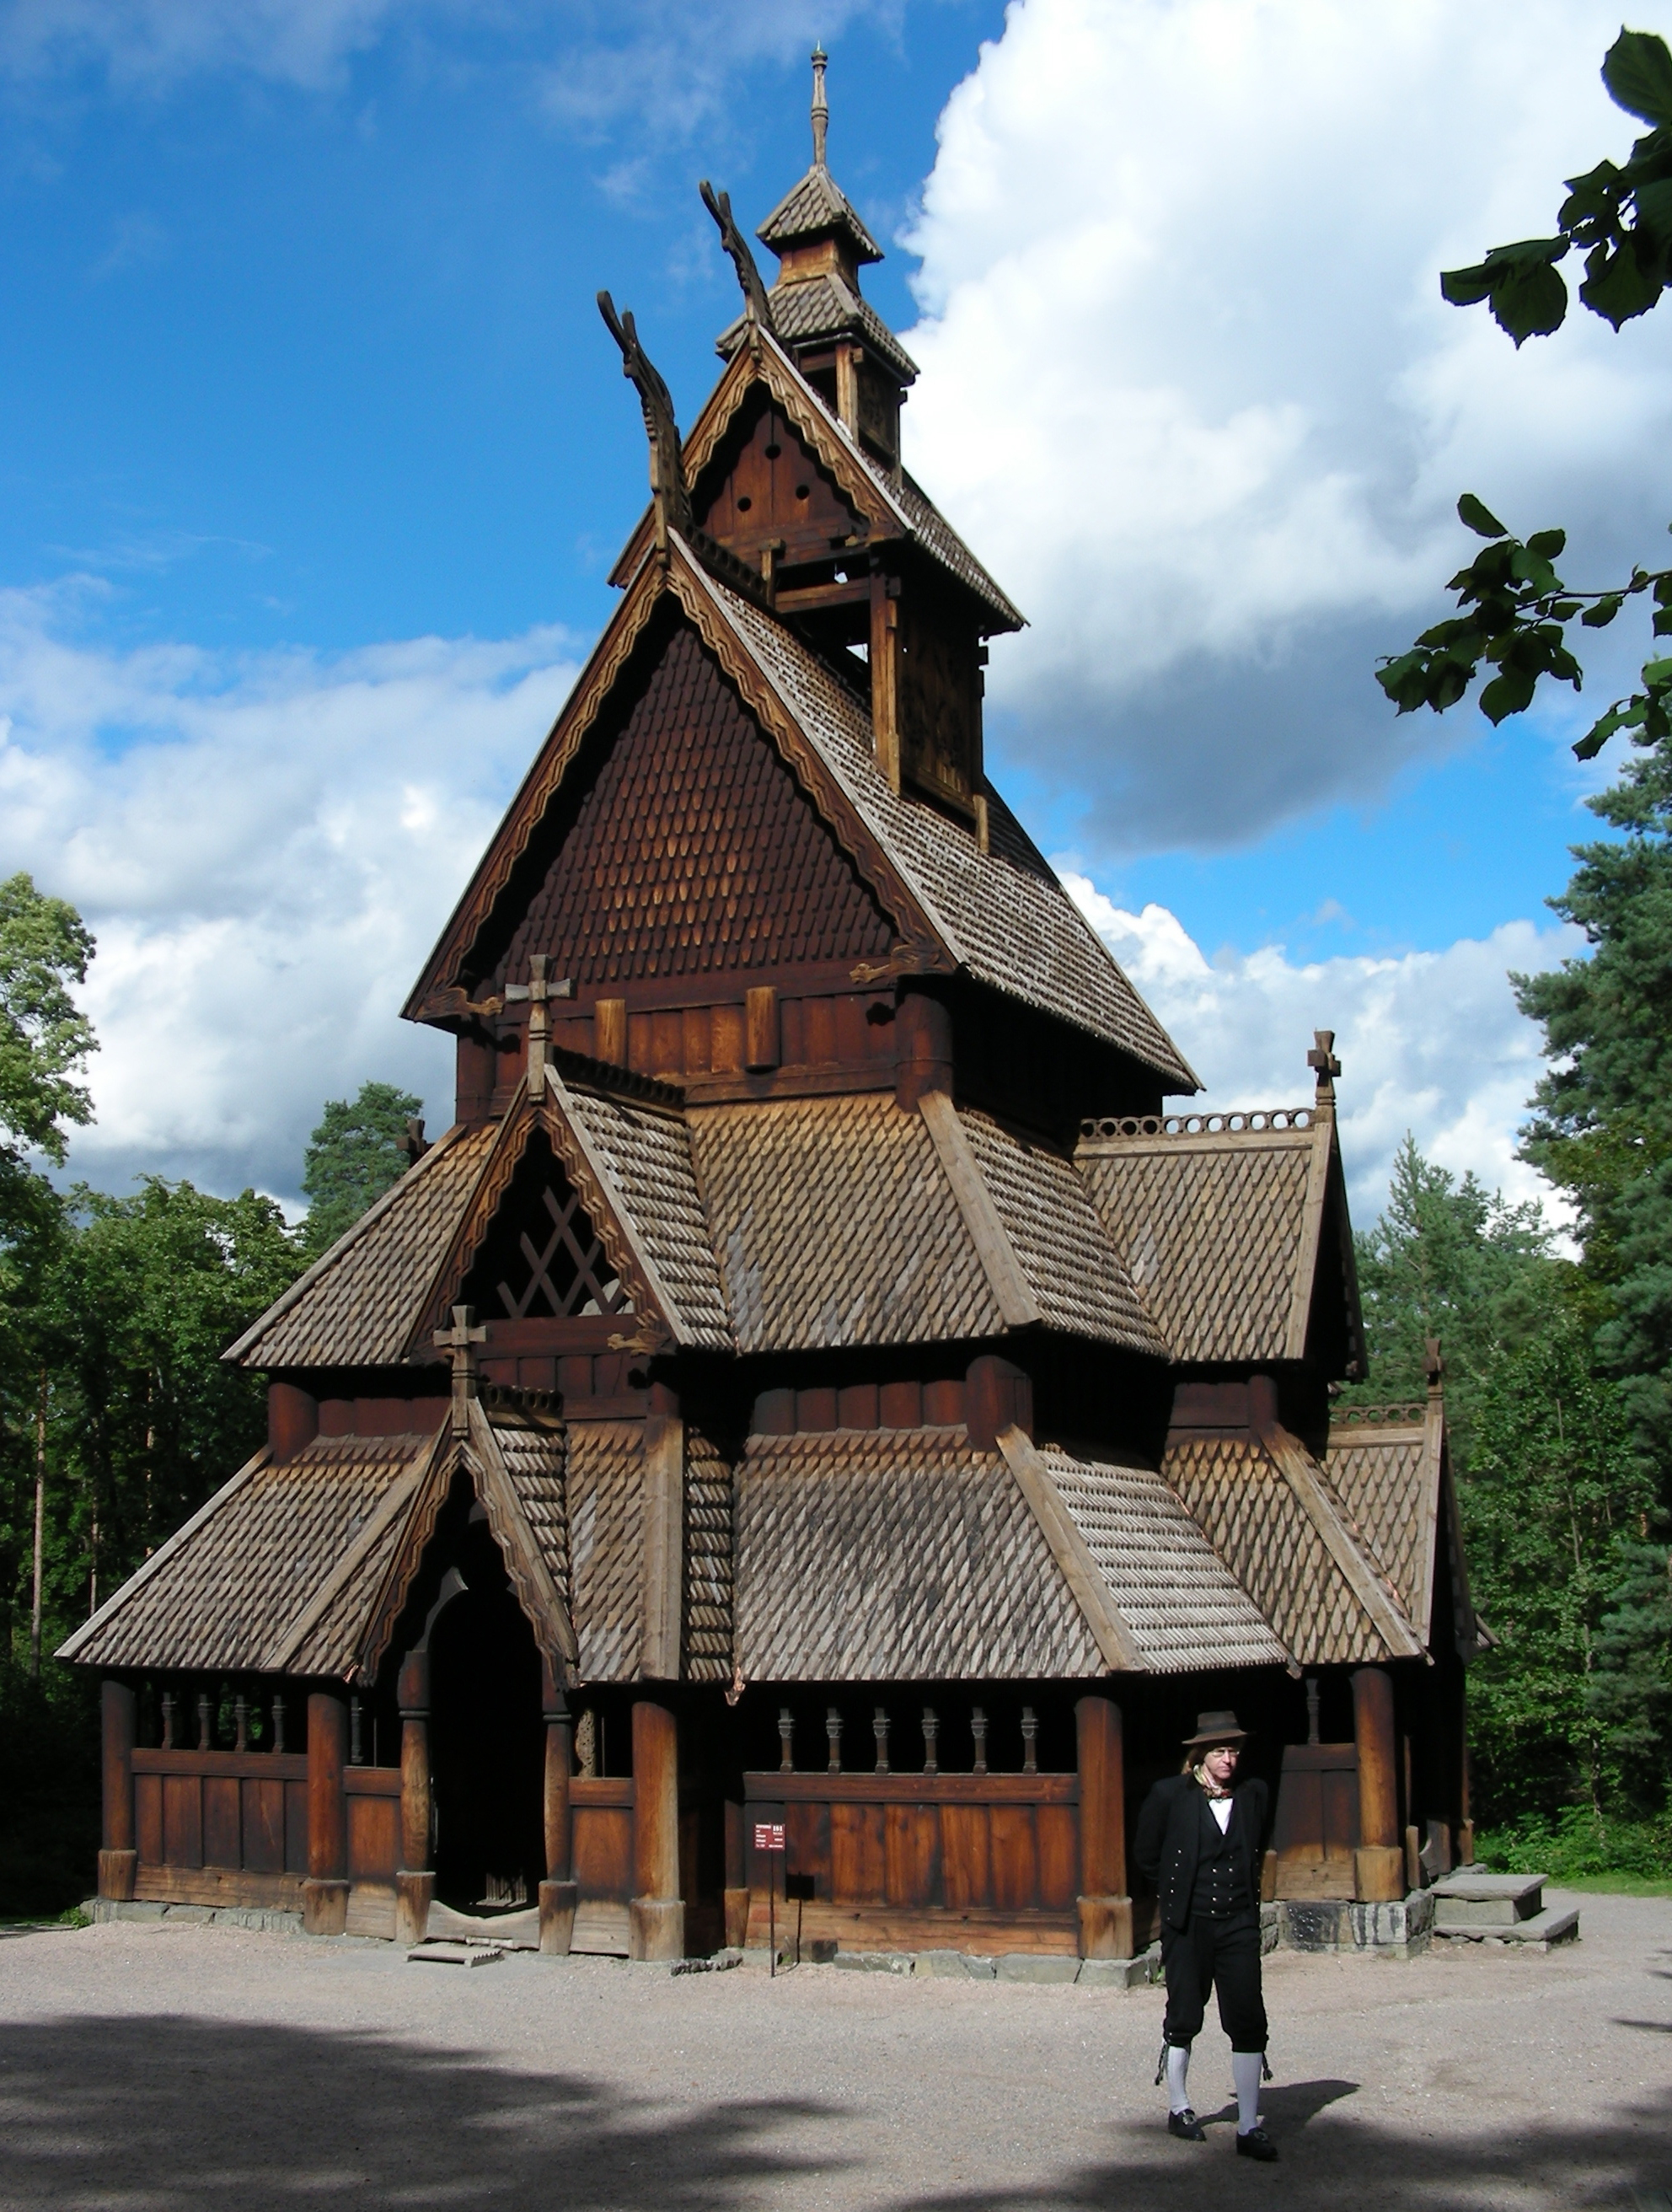
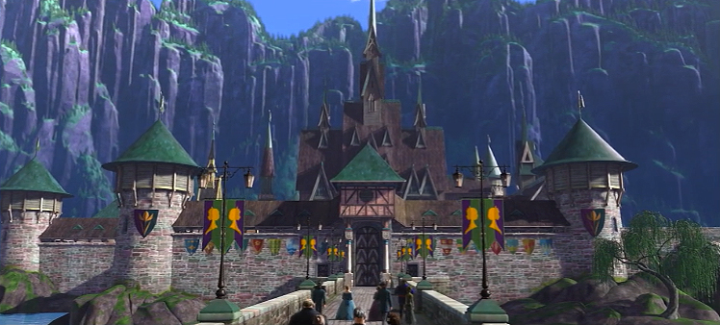
Disney said Akershus Fortress in Oslo was inspiration for Arendelle Castle, but aside from a couple copper spires, the outer architecture looks more like the famous wooden stave churches all over Norway.

Slide 9
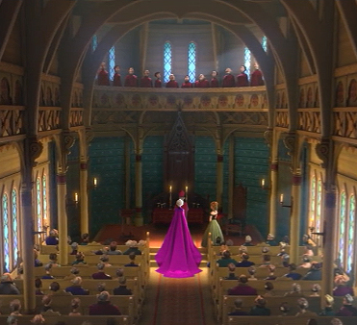
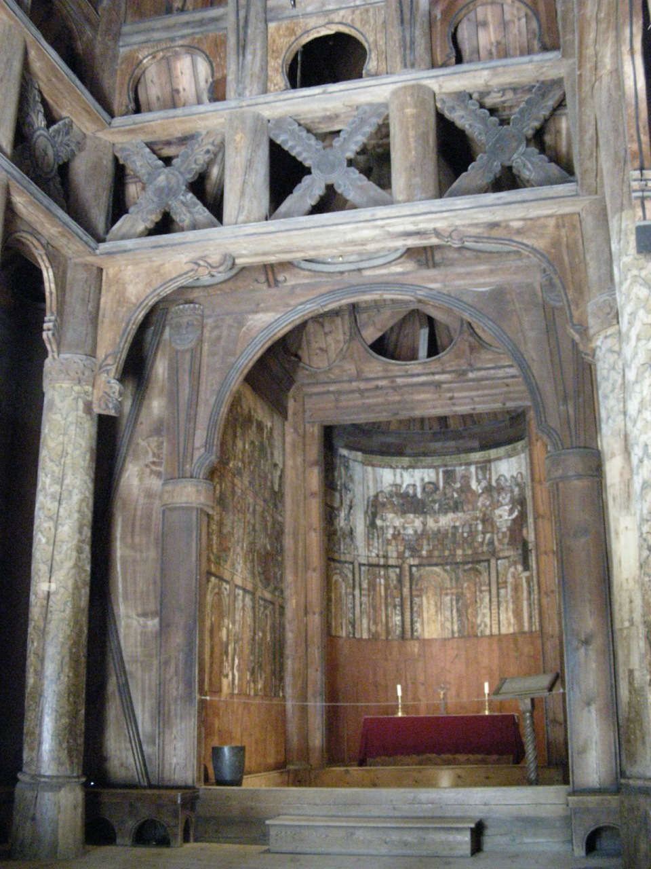
The Arendelle Coronation Chapel is larger but looks inspired by the gorgeous intricate carvings inside of the wooden stave church preserved at the Norsk FolkeMuseum in Oslo.

Slide 10
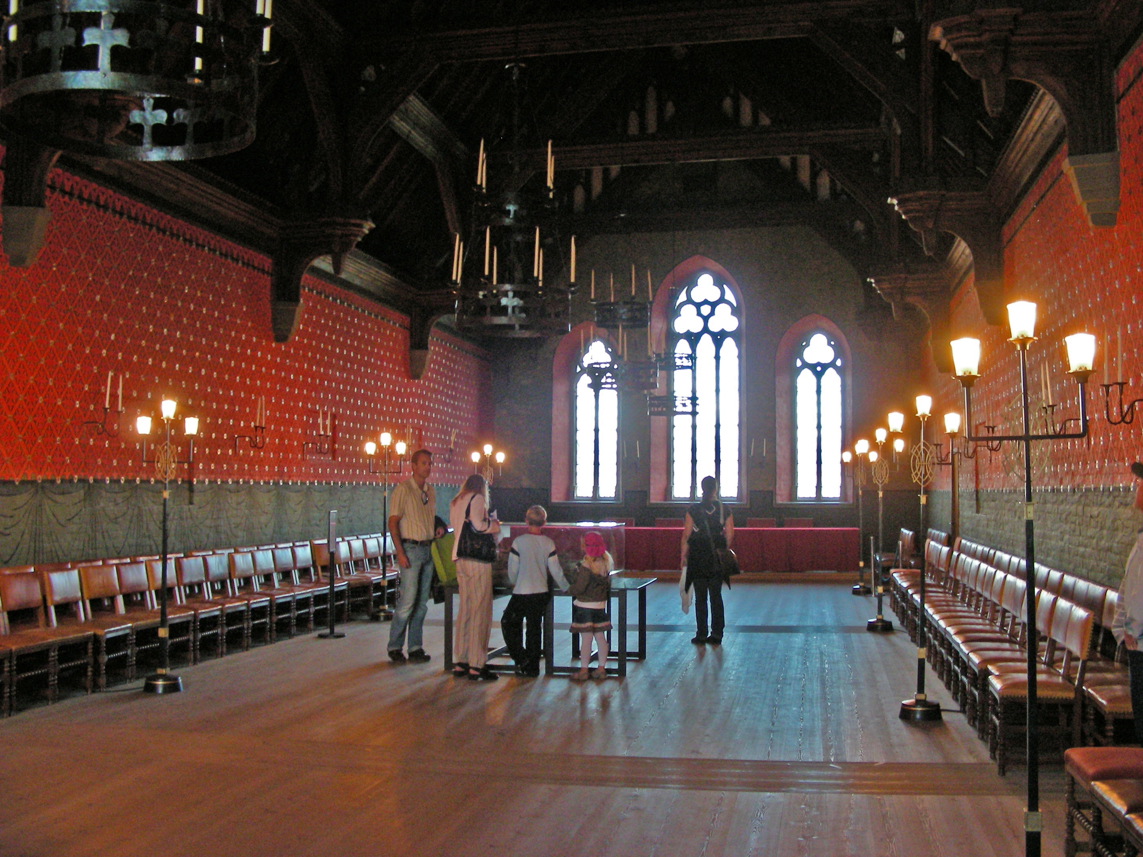
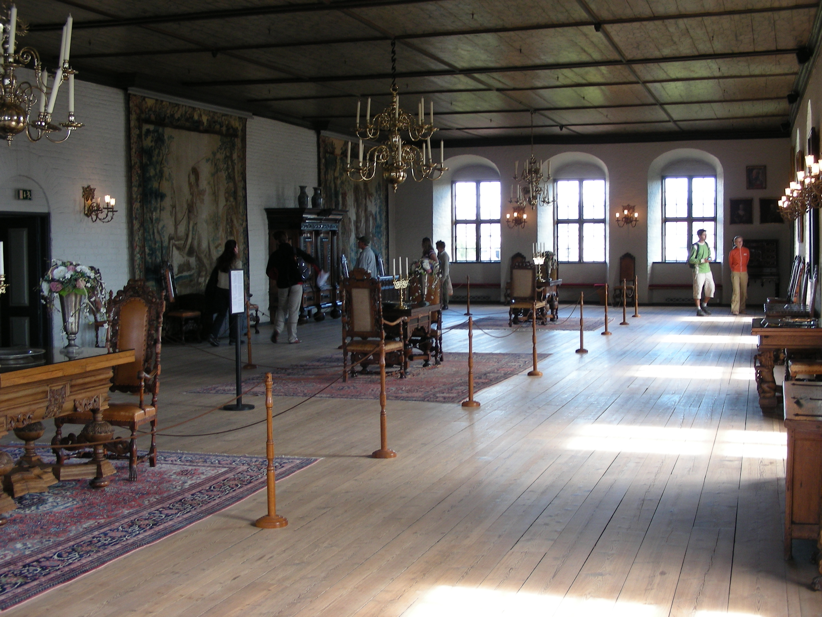
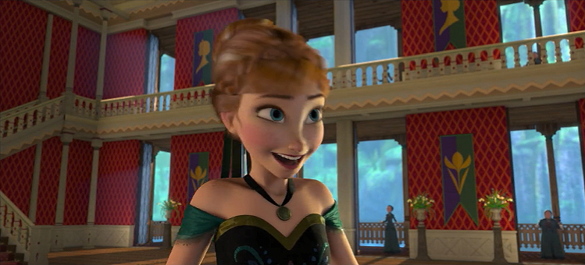
The painted red walls inside Akershus Fortress do appear inside Arendelle Castle, along with large portraits, tall ceilings and windows.

Slide 11
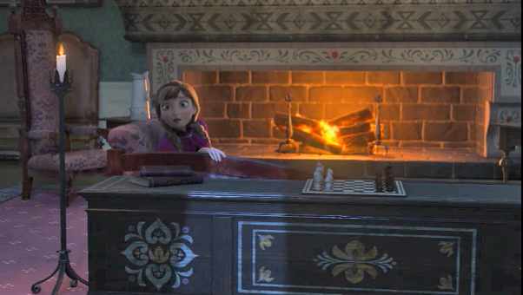
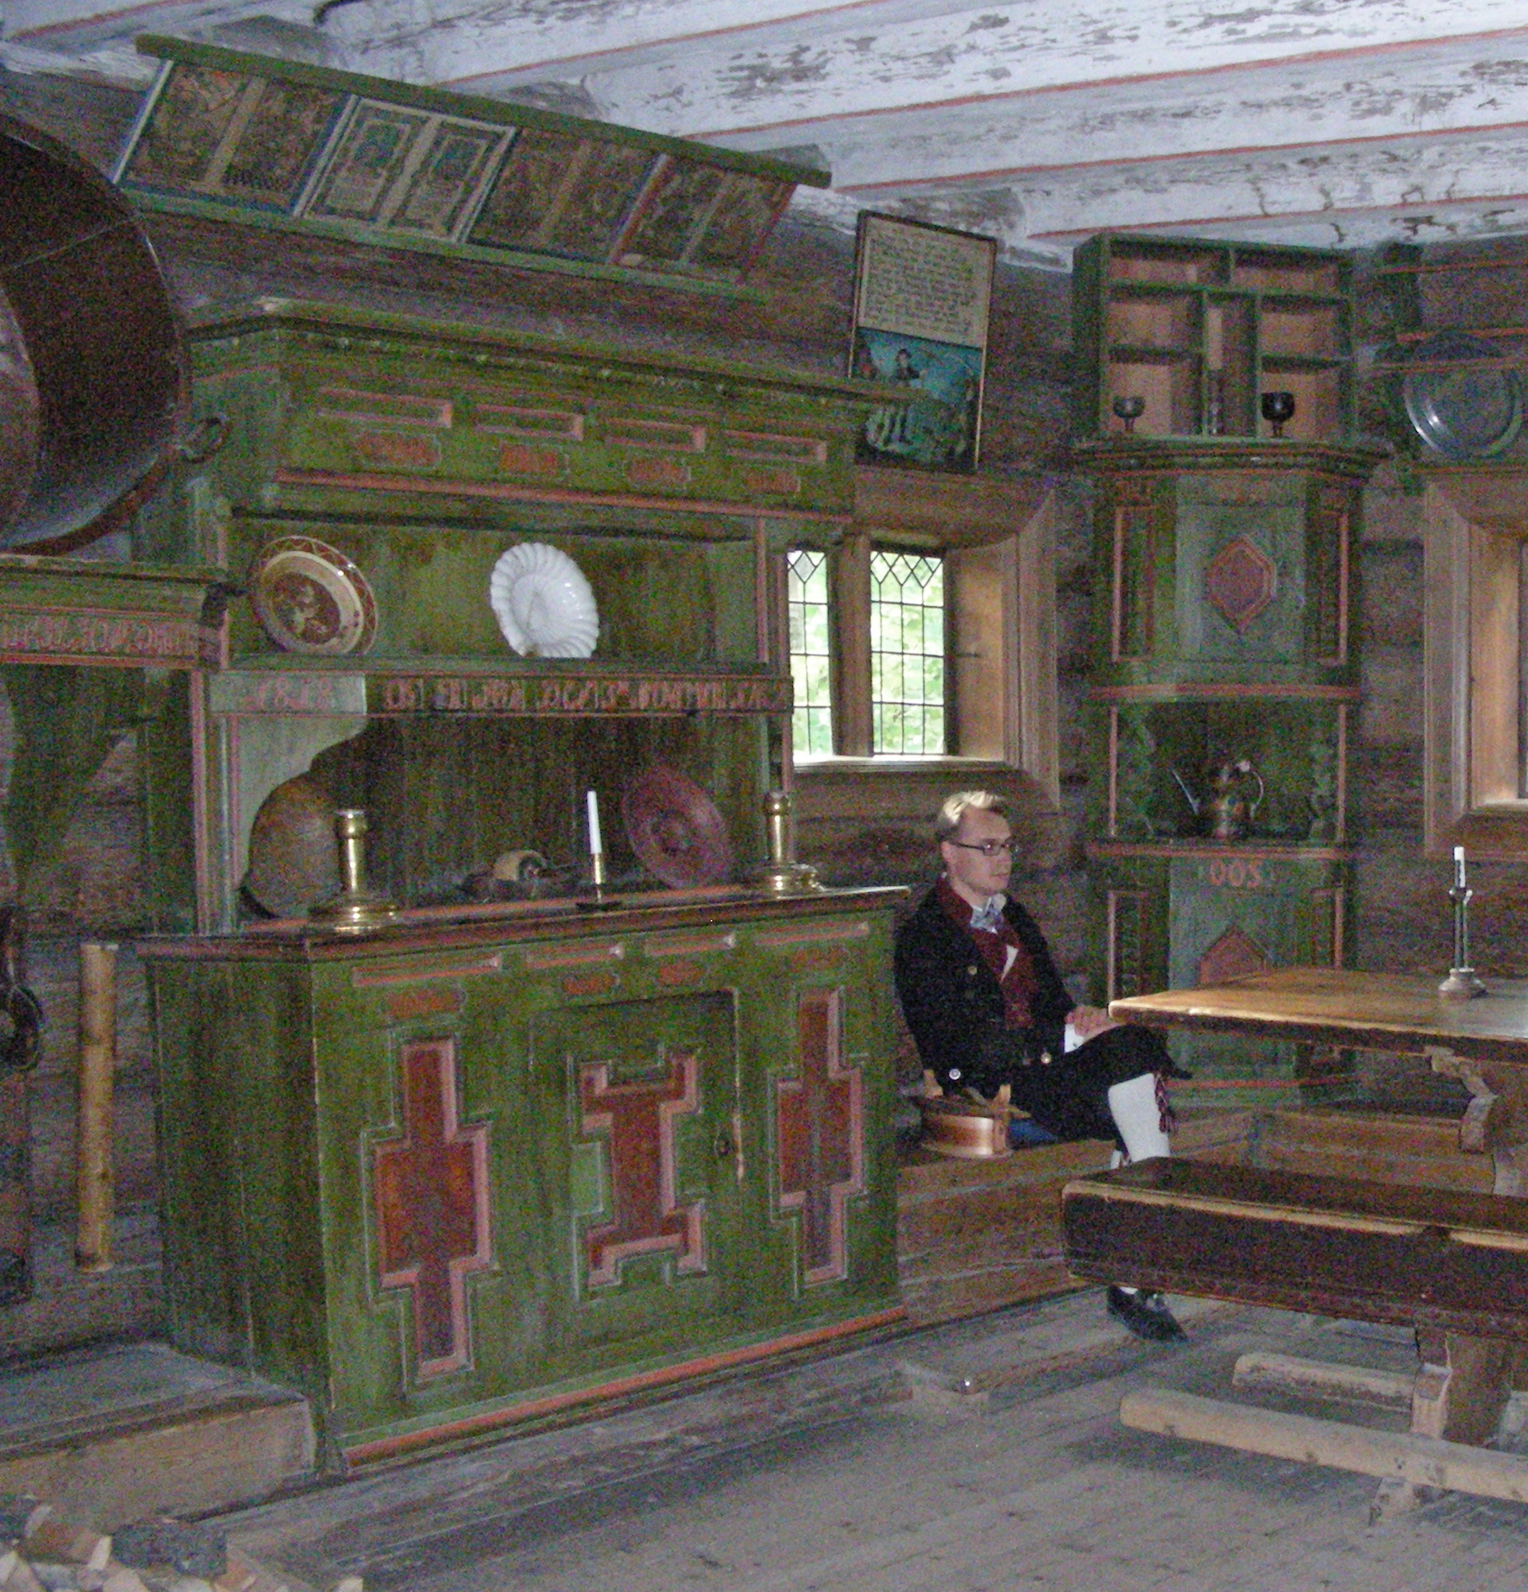
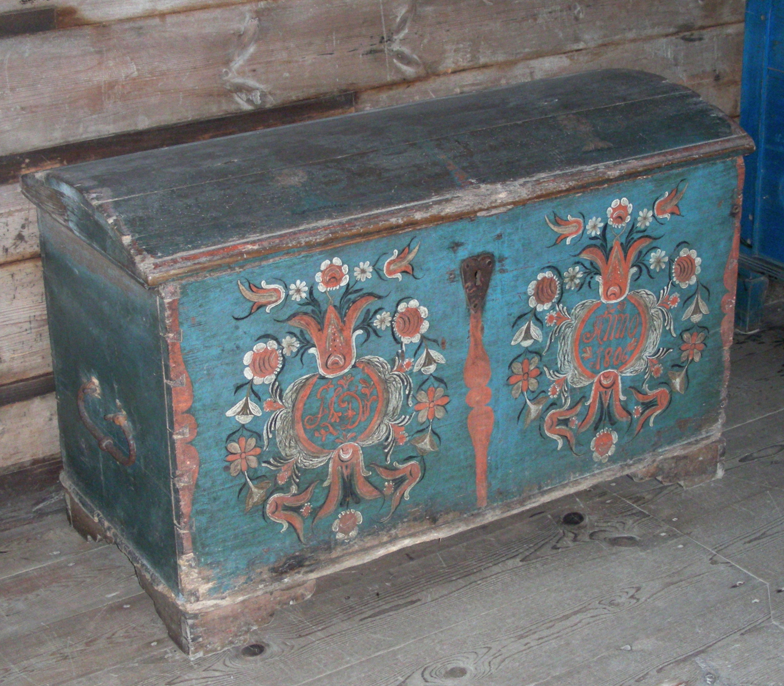
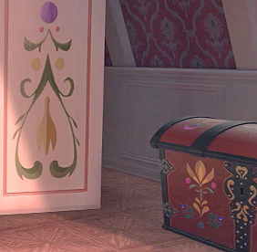
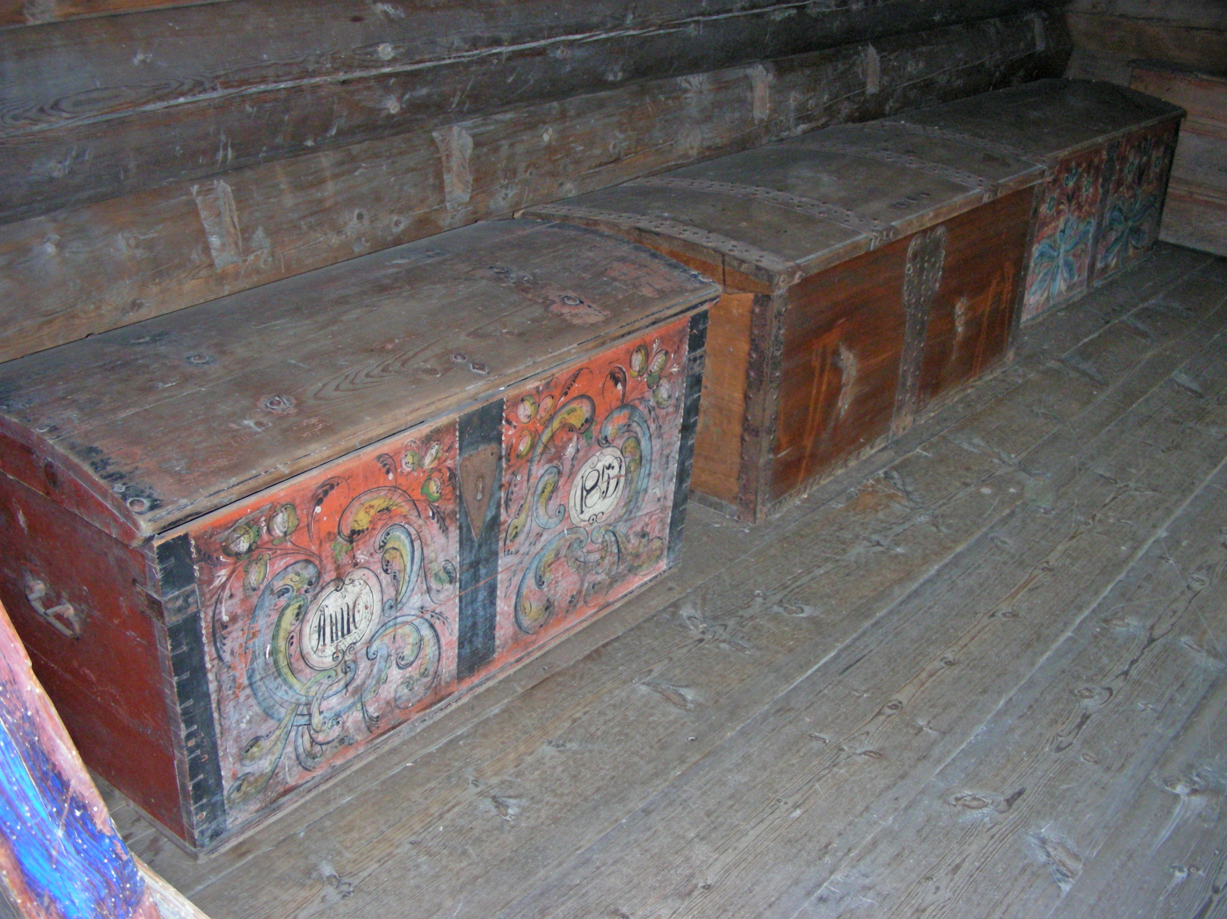
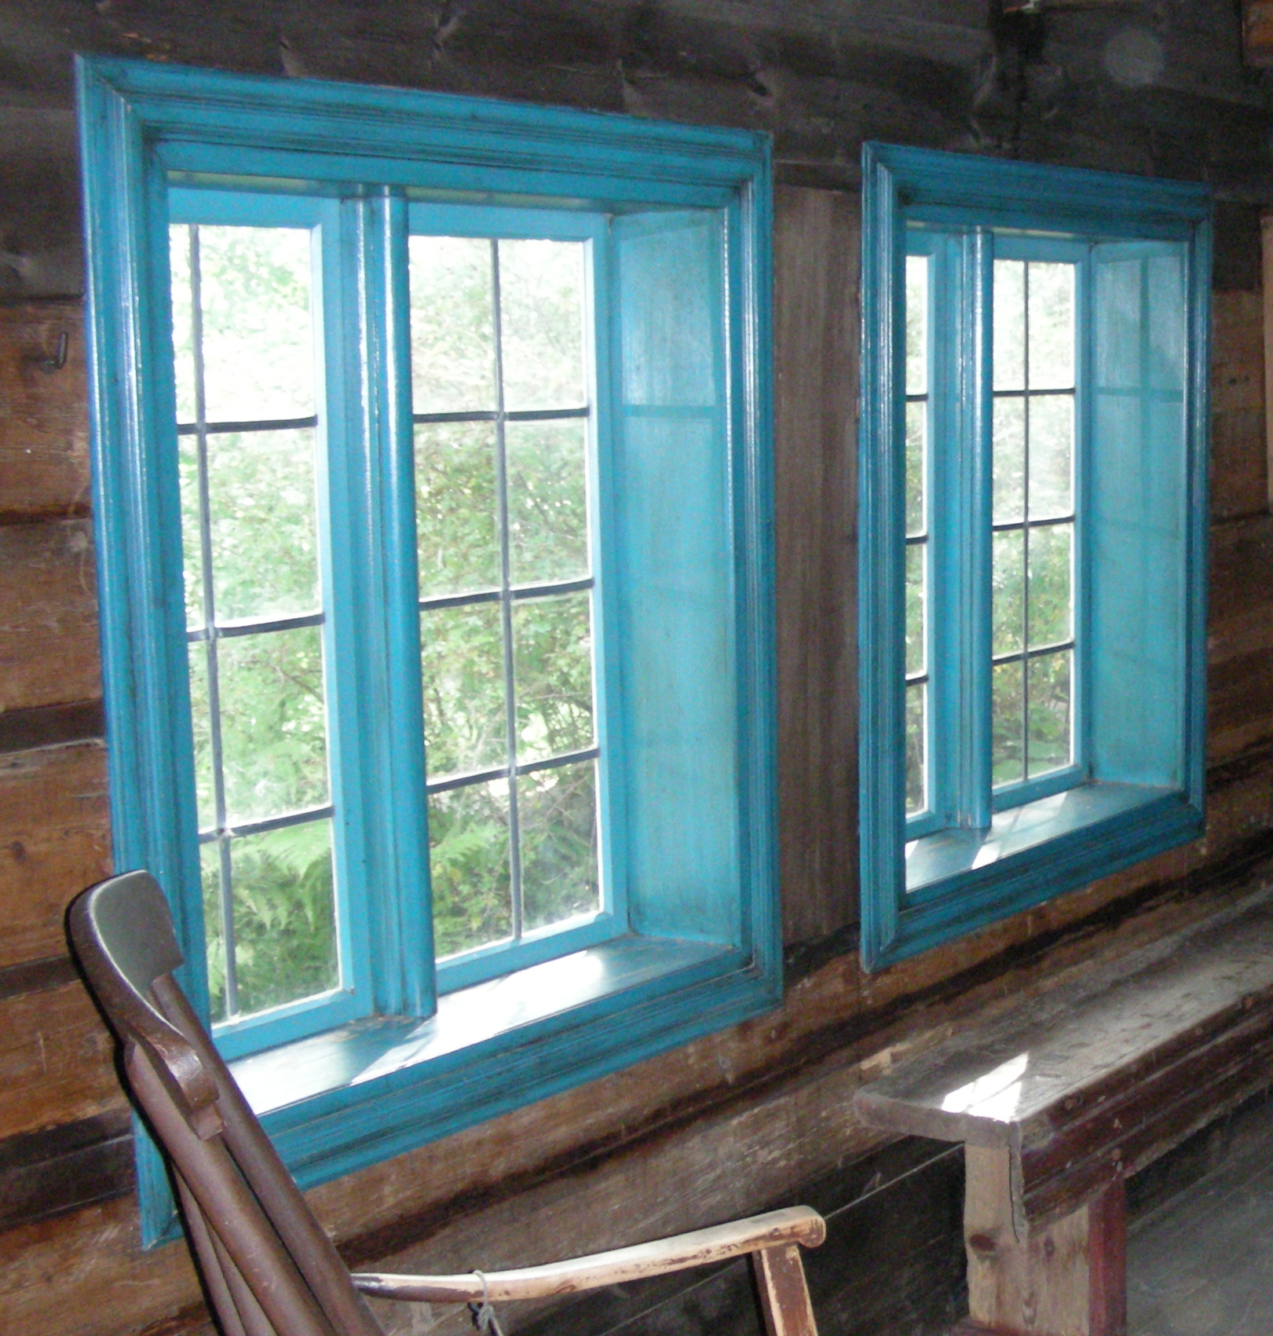
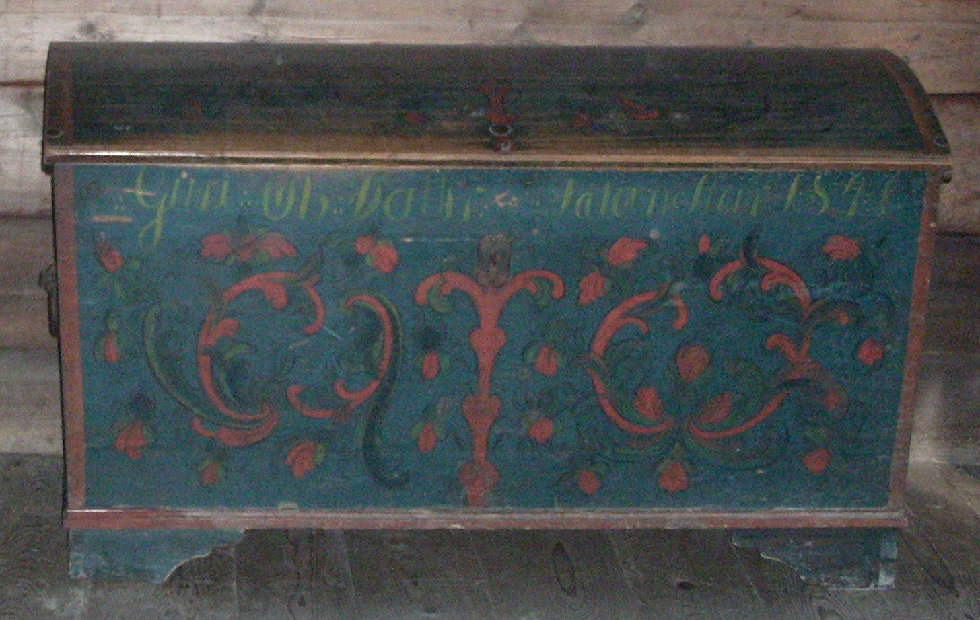
The Norsk FolkeMuseum in Oslo also has many examples of the rosemaling tradition of beautifully painted furniture and walls that obviously inspired décor and accessories inside Arendelle Castle.

Slide 12
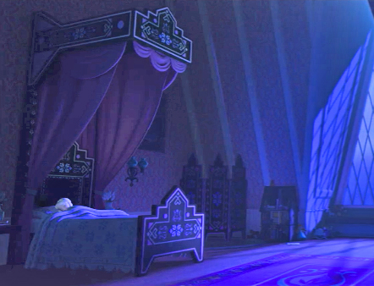
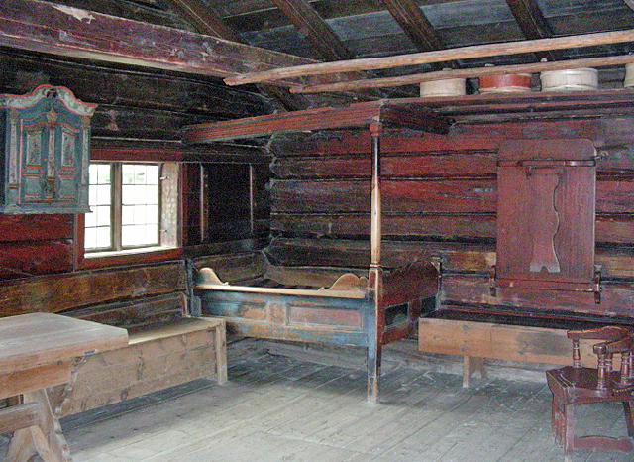
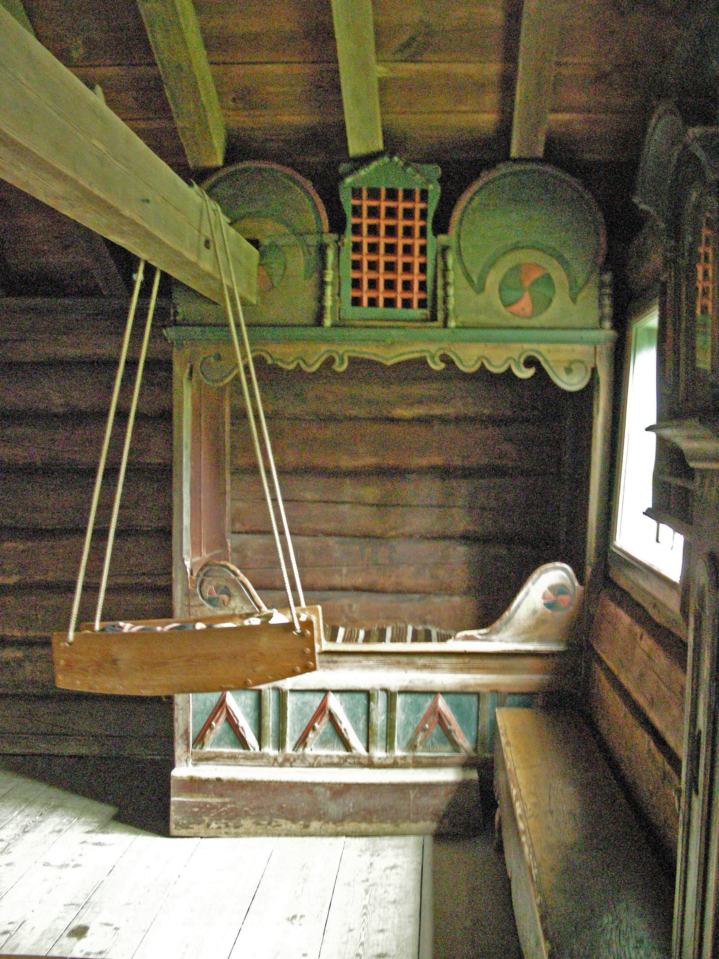
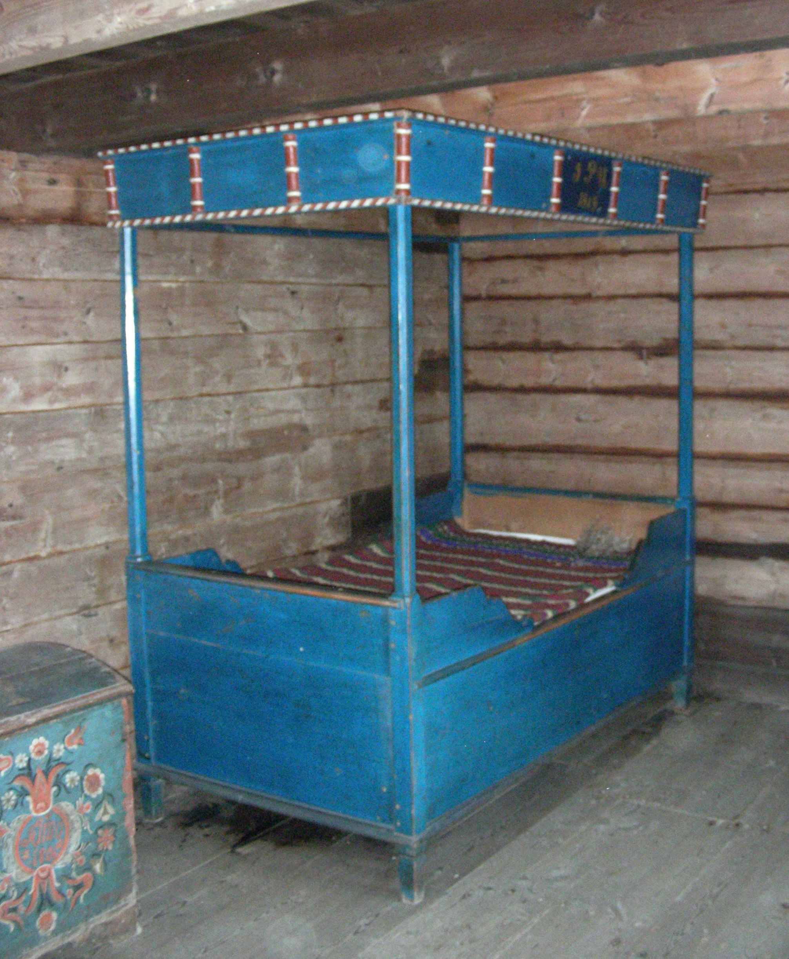
Elsa’s childhood bed is more elaborate, but you didn’t need to be a princess to have a pretty painted bed frame.

Slide 13
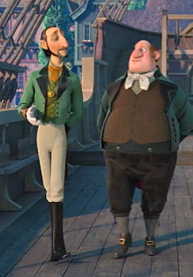
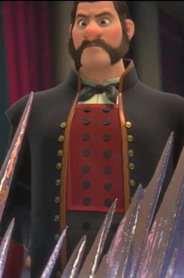
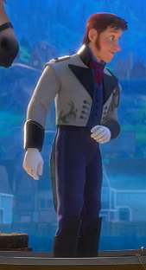
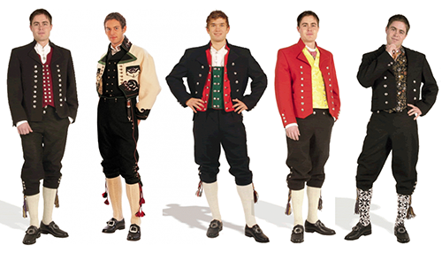
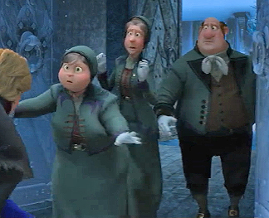
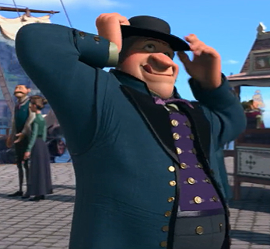
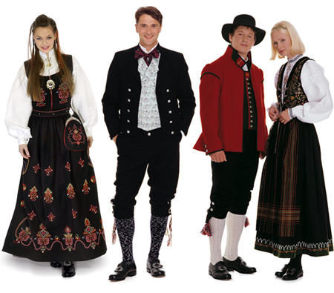
The Arendelle castle staff and many of the men wear clothing inspired by traditional Norwegian men’s bunad.

Slide 14
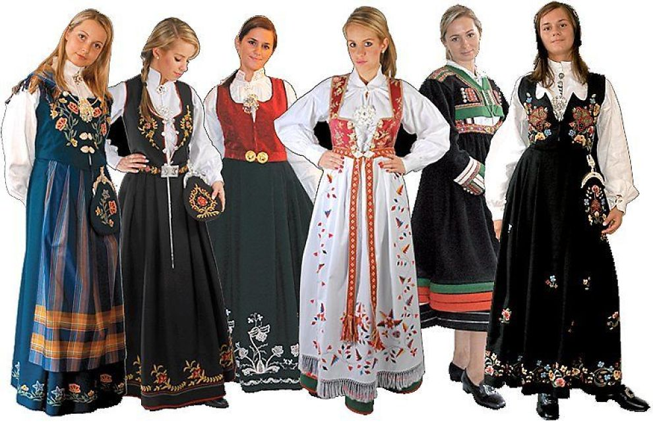
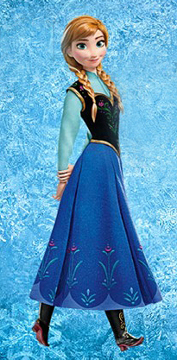
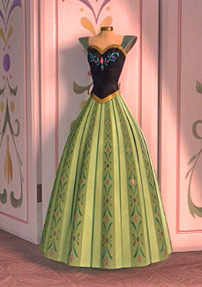
Both of Anna’s dresses are reminiscent of traditional women’s bunad, with dark bodices and embroidered with rosemaling-style designs.

Slide 15
Even Queen Elsa’s coronation dress, matching shoes, and her protective gloves are also decorated with rosemaling-style designs.

Slide 17
I had only seen the video of the song Let It Go and already decided I must make both of Elsa’s dresses before I even saw the movie! It didn’t hurt there were so many of my favorite colors represented.

Slide 18
Sketching began, I found aqua canvas in my stash, purchased other fabrics, and started fitting the corset bodice together.

Slide 19
Since both dresses are full-length skirts with strapless bodices over separate shirts, plus corset construction always needs two sides of fabric, I decided to make a reversible dress, starting with the bodice.

Slide 20
Luckily I had a dark green loose-fitting stretch velvet blouse I could reconfigure into the coronation dress mandarin collar with fitted sleeves. This was my first serger sewing project.

Slide 21
I didn’t trust that much embroidery to remain stretchy, so I used fabric paint brushed onto the velvet while wearing it stretched to shape. It took two coats of paint and I had to keep wearing it as it dried.

Slide 22
Next was the coronation cape, made from fleece so it would drape well but not need hemming and be fairly inexpensive. The shaped shoulders were tricky to fit to myself, and using the stretchy crushed velvet was slippery to sew as trim, but the look was perfect.

Slide 23
Next was the skirt. I found a teal linen-style rayon and an aqua bridal satin, then made a four-panel skirt the maximum width of the smallest fabric. The seams were placed at the legs so one seam could be the slit in the aqua ice dress, but I handstitch the slit closed when wearing the coronation dress. (Yes, my kitties are often “helpful” when I sew.)

Slide 24
Finally some rosemaling! I measured my skirt circumference to calculate the size of the repeat, then sketched the design on paper to make a perfectly symmetrical tagboard stencil. I marked the pattern in chalk, then painted using acrylics with textile medium and the same fabric paints as the velvet shirt, even blending colors.

Slide 25
I needed the bronze ribbon trim in place before I could aim the bodice design, so I sewed the top of the corset together, freehanded the chalk design, then used the same paints as the skirt.

Slide 26
I wanted this bodice to be sturdy, so I used extra-thick half-inch steel boning instead of standard quarter-inch. My new favorite corsetry accessory is the pre-punched lacing stay! Setting the eyelets is always a pain, but with the steel lacing stays inside, they won’t rip out of the fabric over time.

Slide 27
This project was a lesson in dependencies! Painting the skirt was safer unattached to the bodice so I could insert protection against the paint bleeding through, painting the bodice was best before the steel stays were in place, and I could only attach the skirt to the bodice after the stays were in place. Finally I was able to try it on to get the skirt pinned to the bodice, trim the excess, then topstitch in place.

Slide 28
Once the skirt was firmly attached to the bodice, with the raw aqua edge turned under and topstitched down, I trimmed the excess on the teal side so I could topstitch the bronze ribbon trim to hide the raw edges. This was very fussy so I needed all my teal pins to keep everything flat while sewing so many layers!

Slide 29
Since I noticed Elsa’s matching coronation shoes, I couldn’t resist making my own matching shoes! Glad I had a perfect pair of elastic flats, but it required pinning while wearing them so I could handstitch!

Slide 30
No coronation dress would be complete without the actual crown! I didn’t want to use real metal since it would be dangerously sharp, and bending anything else wouldn’t keep the same curve, but a quart yogurt container was perfect and super cheap!

Slide 31
After the coronation dress was done, the ice dress could continue, starting with laminating my own ice fabric, cutting a THOUSAND rectangles to be “ice shingles” and gluing them to the bodice…

Slide 32
The ice bodice took 15 hours of cutting & gluing with stretchable flexible fabric glue over several evenings, but the result was sparkly, shimmery icy rectangles, just like the movie & exactly as I imagined!

Slide 33
For the ice dress shirt, I was lucky to find the perfect aqua stretchy mesh shirt on eBay, but I had to paint it while wearing it to be the correct shape while drying. I used a brush with crystal glitter stretchable fabric paint, and it was tricky to reach behind my arms!

Slide 34
There are only a couple quick shots of Elsa’s ice shoes in the movie, but they are spectacular, so I absolutely had to make them. First I used a box cutter and heavy duty scissors to cut a well-fitting comfortable pair of low-heeled white shoes to the approximate shape.

Slide 35
I made paper patterns of the pointed toe shapes before I cut them from extra “ice shingle” fabric. I stiffened the fabric with several coats of decoupage sealer, both flat and attached in place on the shoes. The bare white shoe surfaces were covered with shimmer aqua fabric paint.

Slide 36
After many, many layers of decoupage sealer, I added crystal glitter paint accents in the angular ice designs. Once those were dry, the pointed toes needed extra protection, so leftover vinyl was added to the soles…then they were ready to compare to the movie!

Slide 37
Elsa’s ice ensemble would not be complete without her sparkling snowflake cape. I knew the blue translucent crinkle shimmer fabric I had used before for fairy wings looked like ice, then snowflakes cut from the white version would layer perfectly without being too solid.

Slide 38
Even though I purposely made the cape not as long as the movie, obviously I needed to cut a LOT of snowflakes. I had been wanting a programmable cutting machine for a while, so I found a deal & splurged. I definitely gave it a workout cutting so many snowflakes!

Slide 39
The middle back of the snowflake cape is large snowflake “arms” with cutout snowflake holes. I sketched and cut the “arms” by hand, but had to cut them apart to fit into the machine to cut the snowflake holes.

Slide 40
The crinkle shimmer fabric was too fragile by itself to be cut by machine, so I used the same double-adhesive interfacing first, cut by machine, then peeled off the backing for iron-on snowflakes. After placing the large border snowflakes, I sewed the two cape layers together in the curve between snowflakes, then continued ironing.

Slide 41
Once all the snowflakes were ironed in place, I transferred the cape to my counter for adding the glitter paint around all the cut snowflake edges plus the scalloped border. It did stick a bit since the fabric is so sheer, but I was able to peel off the fabric and scrape the glitter paint off the counter after it was completely dry.

Slide 42
I did not trim after sewing the curved hem because I used the glitter paint over the hemline to help anchor the edge. The glitter paint wasn’t quite opaque enough, so I added a thin layer of white acrylic, then it was ready to trim along the scalloped edge.

Slide 43
If the dress had not been reversible, the cape could have been permanently attached to the bodice. Instead, I used hooks on the cape and eyes spaced along the top edge of the bodice. To gather the cape depending how tightly the corset was laced, I threaded a thin ribbon through a drawstring casing, which tied at each end to a matching ribbon on the bodice.

Slide 44
Cutting the ice shingles along the top edge left raw edges that I glued down with the aqua shimmer fabric paint. I used the same paint to cover the white eyes for the cape hooks. Ice shingle fabric scraps went into the cutting machine to make hair jewelry, and battery packs were sewn into a pocket on the upper back of the cape for strings of LEDs.

Slide 45
The ice ensemble was ready for a special sing-along showing of Frozen at the Castro Theatre in San Francisco, and for my own backyard movie sing-along in the summer, where we all posed with Olaf.

Slide 46
The coronation dress got its own photoshoot near Santa Cruz, Northern California’s closest answer to Norwegian fjords, and the ice ensemble had a fun photoshoot in my local park, where we were followed around by kids the whole time.

Slide 47
Both dresses made an appearance at Disneyland for Halloween, where we were mobbed again for photos all evening!

Slide 48
For more details and lots more photos, please visit www.BrittaBlvd.com
Thank You!

